Slide 1
Insights from the RISERS Project on Industrial Symbiosis Standardisation
Bridging Research and Standardisation for Green Transitions:
I.Ratman-Kłosińska, IETU
João Santos, ISQ
James Woodcock, International Synergies Limited
Notes:
João has shown us what existing R&I projects tell us about standardisation needs for industrial symbiosis, and James has looked at the R&I priorities that future projects should address.
I would like to finish by looking at the next question: if we identify standardisation as a potential pathway for exploiting research results, what does this mean for the design of the research itself?
Standardisation can be one of the pathways through which Horizon Europe projects valorise and exploit their results. But having standardisation in an exploitation strategy does not automatically mean that a project will generate something that can actually be used in standardisation.

Slide 2
Objective
To present R&I needs and priorities that can support the standardisation of industrial symbiosis and help translate research results into standardisation activities.

Slide 3
Our presentation
Industrial Symbiosis and why its standardisation needs R&I
Izabela Ratman-Klosinska, Institute for Ecology of Industrial Areas , Poland
What existing R&I projects tell us about standardisation needs for industrial symbiosis
João Santos, ISQ , Portugal
R&I priorities for industrial symbiosis standardisation : What should future projects focus on?
James Woodcock, International Synergies Limited , United Kindom
Making research fit for industrial symbiosis standardisation: Key considerations for R&I projects
Izabela Ratman-Klosinska, Institute for Ecology of Industrial Areas, Poland

Slide 4
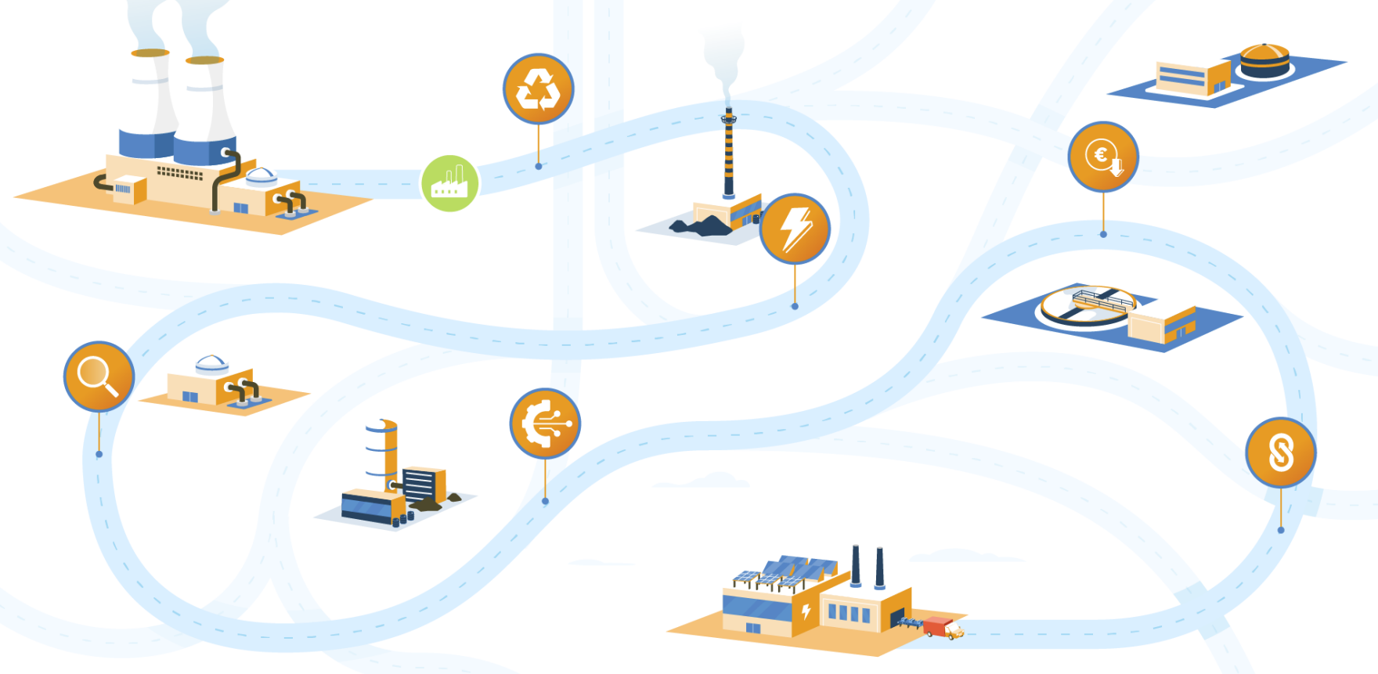
About RISERS
RISERS is a Horizon Europe project aimed to provide an Industrial Symbiosis Standardisation Roadmap supporting the uptake of high impact synergies considering:
identification of the needs, gaps and opportunities
revision of current standards and standardisation efforts relevant for CE and the priority synergies and resources
initiating the process of new standards development (especially for newer technologies and pilot-scale synergies).

Slide 5

Map the landscape of IS-related standardisation to identify specific bottlenecks, gaps, and opportunities for
standardisation and advance the mainstream adoption of priority synergies
Strengthen the engagement of policy making community and the identification of policy frameworks to support IS
Strengthen the uptake of R&I results in
IS standardisation
RISERS
Objectives
Increase stakeholders’ engagement, establishing an active dialogue between the standardisation community and IS practitioners via Hubs for Circularity Community of Practice and discuss the needs and challenges for bringing new technologies and innovative solutions to the market
Develop new and contribute to existing directions for IS standardisation promoting circularity of resources and make recommendations for the development of new standards (standardisation roadmap)

Slide 6









Our Consortium

Slide 7
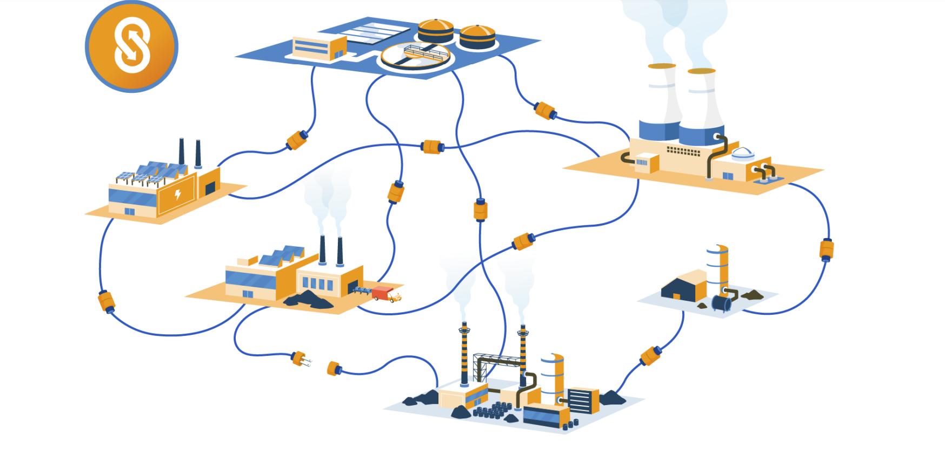
Industrial Symbiosis
Industrial symbiosis is the use by one company or sector of underutilised resources broadly defined (including waste, by-products, residues, energy, water, logistics, capacity, expertise, equipment and materials) from another, with the result of keeping resources in productive use for longer.
Definition from CEN Workshop Agreement 17354

Slide 8
Why industrial symbiosis standardisation needs R&I
R&I role is to fill knowledge and evidence to address IS standardisation gaps.
Develop harmonised methods and metrics
Create and validate common terminology, KPIs, assessment methods, testing approaches and calculation rules.
Enable cross-sector interoperability
Develop common data formats, protocols, interfaces and information requirements so different sectors and systems can work together.
Support standardisation of emerging solutions
Investigate new materials, technologies and circular practices where established normative guidance does not yet exist.
Provide pre-normative evidence
Test performance, safety, durability and wider applicability so the Standardisation Bodies have sufficient evidence to build consensus and develop or revise standards.
RISERS IS Standardisation Roadmap
HORIZONTAL FOUNDATIONS GAPS
Need for common terminology, metrics, methods and data
SECTORAL PRIORITY AREAS GAPS
Need for evidence, testing and validation for specific materials, technologies and applications
SYSTEM-LEVEL ENABLERS GAPS
Need for Interoperability, infrastructure, governance and cross-sector integration
Notes:
IS standardisation faces gaps that cannot be solved by standardisation alone. R&I can provide the scientific and technical basis needed to address them.

Slide 9
What existing R&I projects tell us about standardisation needs for Industrial Symbiosis
João Santos (ISQ)
02-10-2026

Slide 10
SCOPE
Identify critical deficiencies (needs and gaps) in existing standardisation frameworks that hinder the deployment of Industrial Symbiosis:
  Over 150 research and innovation projects were screened (IS and CE).
  21 were identified as highly relevant (standards, policies & technology).
  13 strategic Topic Areas:
    3 Horizontal Areas: Industrial Symbiosis in General, End-of-Waste, and Digitalisation & Data.
    10 Vertical Areas: Steel, Batteries, Packaging, Waste Heat, Textiles, Energy Data, Biomass, Construction, Finance & Market, and Life Cycle Assessment.

Slide 11
HORIZONTAL GROUPS
Industrial Symbiosis in General
  Absence of universal standards for core terms like "CE" and "IS” leading to inconsistent vocabulary.
  Lack of coordinated KPIs for monitoring circularity and resource productivity.
  Existing frameworks are often "product-centric" rather than holistic.
End-of-Waste
  Current standards focus on "end-of-pipe" solutions (treatment/disposal) rather than reuse and recycling.
  There is a critical need for harmonised criteria to distinguish waste from secondary raw materials.

Slide 12
HORIZONTAL GROUPS
Digitalisation & Data
  Lack of interoperability and scalability across diverse energy-intensive industries.
  Urgent need for priority harmonised standards to make DPP operational (e.g., unique identifiers, data carriers, and security protocols).

Slide 13
VERTICAL GROUPS
Steel
  Absence of formal standards for cross-sectoral steel recycling management.
  Additional gaps in the definition, classification, testing, analysis, and technical delivery requirements for metallurgical products.
Batteries
  Critical need for interoperability standards for swappable battery systems across different vehicles and manufacturers.
  Lack of normative guidance for the industrial re-use and performance assessment of second-life batteries.

Slide 14
VERTICAL GROUPS
Packaging
  Standardisation needs concern shapes, formats, and materials, which should be harmonised to simplify reuse, sorting, and recycling.
  New biopolymers often lack specific application standards because they have not yet reached a significant market share or been assigned to a specific TC.
Waste Heat
  Absence of EU-level legislation and standardised contracts, such as Heat Purchase Agreements, between suppliers and network operators.
  Existing heat pump standards are inclined toward space heating and do not account for industrial processes.

Slide 15
VERTICAL GROUPS
Textiles
  Standardisation is needed for tags, QR codes and other data carriers that can support high-speed automated sorting.
  Testing methods are lacking to verify actual recycled content in man-made cellulosic fibers.
Energy Data & Grids
  Existing energy efficiency standards (like ISO 50001) need adaptation for inter-plant energy exchanges.
  Standardisation is required to measure and report energy data exchange to provide transparency.

Slide 16
VERTICAL GROUPS
Biomass
  Insufficient standards governing the general requirements of biomass resources (e.g. quality, variability, and properties measurement).
  Confusion between bio-based content and biodegradability (need for rules on biogenic carbon assessment).
Construction
  Outdated mandates from the 1990s/2000s do not meet current needs and standards.
  Absence of standardised assessment methods to quantify the release of dangerous substances from construction products.

Slide 17
VERTICAL GROUPS
Finance & Market
  Long time for implementing standards in the market. The current process is viewed as too complex, necessitating simpler access for stakeholders.
  Absence of standards for sustainable finance (e.g. green bonds) and grave deficiency in the involvement of standardisation bodies.
Lyfe Cycle Assessment
  Need of a unified standardised framework linking circular economy principles, eco-design, and LCA.
  Lack of specific standards for calculating material and energy intensities from a life-cycle perspective.

Slide 18
IN SUMMARY
Key Findings
  Current frameworks are insufficient to support IS implementation.
  Absence of a unified European framework for Industrial Symbiosis.
  Fragmented End-of-Waste (EoW) criteria.
  Insufficient digital and data interoperability standards.
Strategic Insights
  Standardisation is the critical enabling mechanism for scaling IS.
  Prioritise the alignment between research outputs and standardisation development processes.

Slide 19
IN SUMMARY
Expected Impact
  Faster market uptake of innovative IS solutions.
  Reduced regulatory uncertainty for circular business models.
  Improved interoperability and data-driven decision-making.

Slide 20
R&I priorities for IS standardisation
What should projects focus on?
James Woodcock
International Synergies Limited
02 October 2026

Slide 21
Recap
Standardisation is important to operationalise industrial symbiosis at scale across European industry.
Current standards do not adequately support the cross-sector, collaborative nature of industrial symbiosis.
The absence of common terminology creates inconsistency and slows adoption.
The lack of harmonised End-of-Waste rules creates legal and commercial uncertainty for secondary materials

Slide 22
Connecting standards with the digital landscape
Digitalisation is a major enabler, but requires robust standards for:
  Data interoperability.
  Access rights.
  Security.
  Traceability.
  Verification.
  Digital Product Passports.

Slide 23
Where do we need to go?
Future R&I projects should treat standardisation as a core part of impact, dissemination and market uptake — not as an optional add-on.
CEN Workshop Agreements are a useful, faster route for standardising innovative research outputs.
Europe needs to move away from isolated sector silos and towards horizontal standardisation covering circularity, environmental performance, resource efficiency and data exchange.
There is also a need for new professional roles and training to help research teams navigate standards, regulation and market implementation.

Slide 24
Areas to embed/focus on going forward
Develop a common European vocabulary for Industrial Symbiosis
  Create shared definitions, indicators and methodologies (TC465).
Create harmonised End-of-Waste criteria
  Clarify when waste becomes a product or secondary raw material.
  Reduce uncertainty for regulators, producers and buyers.
Engage standards bodies early in R&I projects
  Involve Technical Committees, Working Groups and standardisation experts from the beginning (is there capacity within TCs).
Use CEN Workshop Agreements more actively
  Use CWAs as a faster and more flexible route where formal standards do not yet exist.

Slide 25
Areas to embed/focus on going forward
Align research outputs with standards revision cycles
  Time project results so they can influence future standards.
Include standardisation training in project consortia
  Help research teams understand how standards are developed and used.
Prioritise pre-normative research
  Generate the testing, data and validation needed before new standards can be created.
Focus on cross-cutting standards
  Prioritise circularity metrics, environmental indicators, data exchange, traceability and resource-efficiency methods.

Slide 26
Areas to embed/focus on going forward
Strengthen links between SRIAs and standardisation
  Future strategic agendas should explicitly include standardisation pathways.
Support sector-specific standardisation work
  Especially in batteries, textiles, construction, plastic packaging, waste heat, steel, biomass, energy data and LCA.
Create stronger market and finance mechanisms
  Link standards with market acceptance, ESG investment, green finance and secondary-material confidence.
Develop new professional roles
  Support specialists who can bridge technical innovation, regulation, standards and industrial implementation.

Slide 27
Areas to embed/focus on going forward
Consider areas that receive constant repetition and create a standardised bank of knowledge
  State of the art
  Review of historical applications
  KPI development
The bank could be used as a starting point for these areas.
New projects add to the bank, rather than create all from first principles
This aspect could potentially save €millions of repetitive work

Slide 28
Implications for European R&I funding
Make standardisation an explicit requirement in funding calls
Fund pre-normative research
Prioritise horizontal, cross-sector funding topics
Support faster routes to standardisation
Align funded projects with standards revision cycles
Build standardisation capacity inside consortia
Strengthen links between SRIAs and funding work programmes
Use funding to reduce regulatory and market uncertainty
Target sector-specific standardisation gaps
Link standardisation with finance and market uptake

Slide 29
Making research fit for industrial symbiosis standardisation
Designing R&I activities that can generate evidence for IS standardisation
I.Ratman-Kłosińska, IETU
Notes:
João has shown us what existing R&I projects tell us about standardisation needs for industrial symbiosis, and James has looked at the R&I priorities that future projects should address.
I would like to finish by looking at the next question: if we identify standardisation as a potential pathway for exploiting research results, what does this mean for the design of the research itself?
Standardisation can be one of the pathways through which Horizon Europe projects valorise and exploit their results. But having standardisation in an exploitation strategy does not automatically mean that a project will generate something that can actually be used in standardisation.

Slide 30
Focus
Research results do not automatically enter standards.
What themes, research activities and validation should we build into an R&I project if we want it to generate a credible evidence base for future industrial symbiosis standardisation?
Notes:
So my focus is very practical: what themes, research activities and validation should we build into an R&I project if we want it to generate a credible evidence base for future standardisation of industrial symbiosis?

Slide 31
Standardisation is an exploitation/knowledge valorisation pathway
Standardisation can be one pathway for exploiting R&I results.
The use of results in further research and innovation activities other than those covered by the action concerned, including among other things, commercial exploitation such as developing, creating, manufacturing and marketing a product or process, creating and providing a service, or in standardisation activities.
Notes:
Standardisation is one of the possible pathways through which project results can be taken forward an deliver a long lasting impact far beyond the project.

Slide 32
Standardisation guidance for R&I projects exists
Existing resources already help projects with:
understanding standardisation and its role in R&I
analysing the standardisation landscape
identifying relevant standards and standardisation activities
engaging with standardisation organisations
identifying possible standardisation pathways and deliverables
integrating and planning standardisation activities within the project.
Guidance and support already available
CEN-CENELEC Guide 23 Research Consortium Bridge- Addressing Research and Innovation in European Standardization activities and deliverables
Guide 29 ‘CEN and/or CENELEC Workshop Agreements – A rapid way to standardization’
CEN-CENELEC / Standards+Innovation
Code of practice on standardisation in the European Research Area
Horizon Standardisation Booster
Hubs4 Circularity Knowledge Platform
Notes:
There is alredy a lot of uisance available on how to incorporate standardisation into a project, there is also a posibility to et suport from the Horizon Sandardisation Booster service , my objective for today is not to repeat what these guidance materials provide, but con centrate really on the research needed and how to plan it in suport of the research needs relevant for standardisation with James and Joao presented to you.

Slide 33
What makes an R&I result potentially useful for IS standardisation?
Relevant
Evidence-based
It addresses a problem where different actors actually need a common approach
The project generates evidence demonstrating that the approach is reliable for its intended use.
Concrete output
Transferable
The project produces something that can potentially be shared or applied: a method, terminology, classification, dataset, criteria, assessment approach, etc.
The result is not dependent only on one pilot, one company or one specific local situation.
Notes:
Looking across the RISERS material, I think we can reduce the problem to four basic requirements.
First, the research needs to address a real need for a common approach. Not every industrial-symbiosis challenge needs standardisation.
Second, the project needs to produce something concrete. It could be terminology, a classification system, a measurement method, common data requirements, quality criteria or an assessment approach.
Third, that result needs an appropriate evidence base.
And fourth, we need to know whether it is applicable beyond the particular pilot where it was developed.
These four dimensions are more useful for R&I design than simply asking whether a project “has a standardisation activity”

Slide 34
Designing R&I contributions to industrial symbiosis standardisation: a stepwise approach
9 STEPS
Analyse the existing standardisation landscape
Assess transferability and wider applicability
Consider links between different R&I needs
Identify and engage relevant stakeholders
2
4
6
8
1
3
5
7
9
Identify the relevant R&I need(s)
Formulate the potential standardisation-related challenge
Define what R&I should provide
Plan the evidence needed
Link the R&I contribution to possible standardisation action

Slide 35
Step 1 Identify the industrial symbiosis R&I need
Sector-specific needs
Horizontal needs
System level needs
Linked to a particular material, technology, resource stream or application
Examples:
material-specific characterisation
application-specific test methods
performance, quality or safety evidence
validation under relevant industrial conditions
Relevant across sectors or IS applications
Examples:
terminology and definitions
resource classification and descriptors
data structures and interoperability
measurement and assessment approaches
common KPIs, quality criteria or verification approaches
Wider enabling and upskaling conditions for IS
Examples:
infrastructure & spatial planning
governance & contracting
information sharing
skills and competences
Financing & investment conditions
Organisational, institutional, regulatory barriers & enablers
Notes:
These categories help identify where R&I is needed; they do not imply that every need should result in a standard.

Slide 36
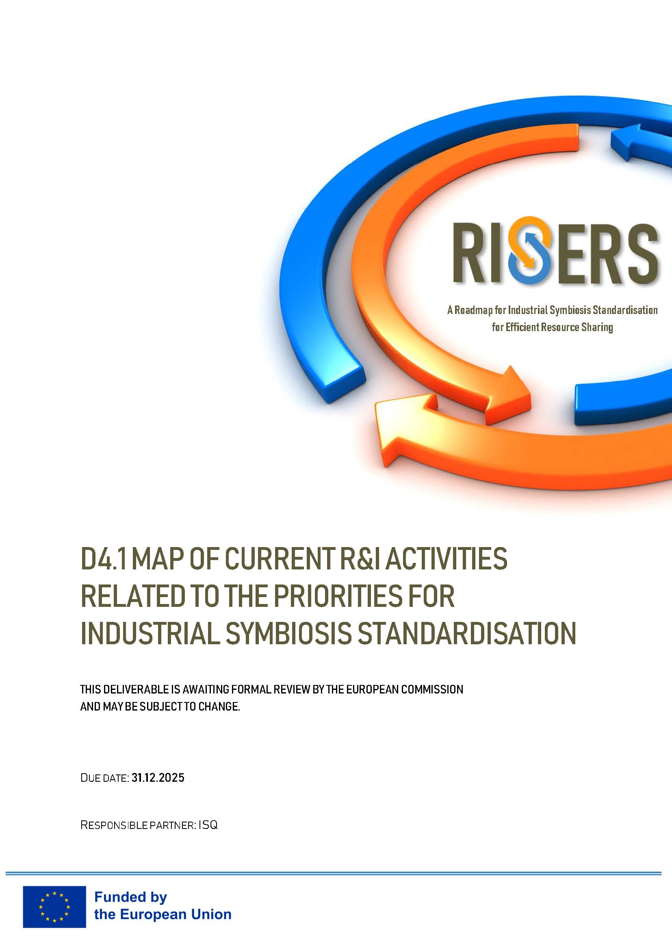
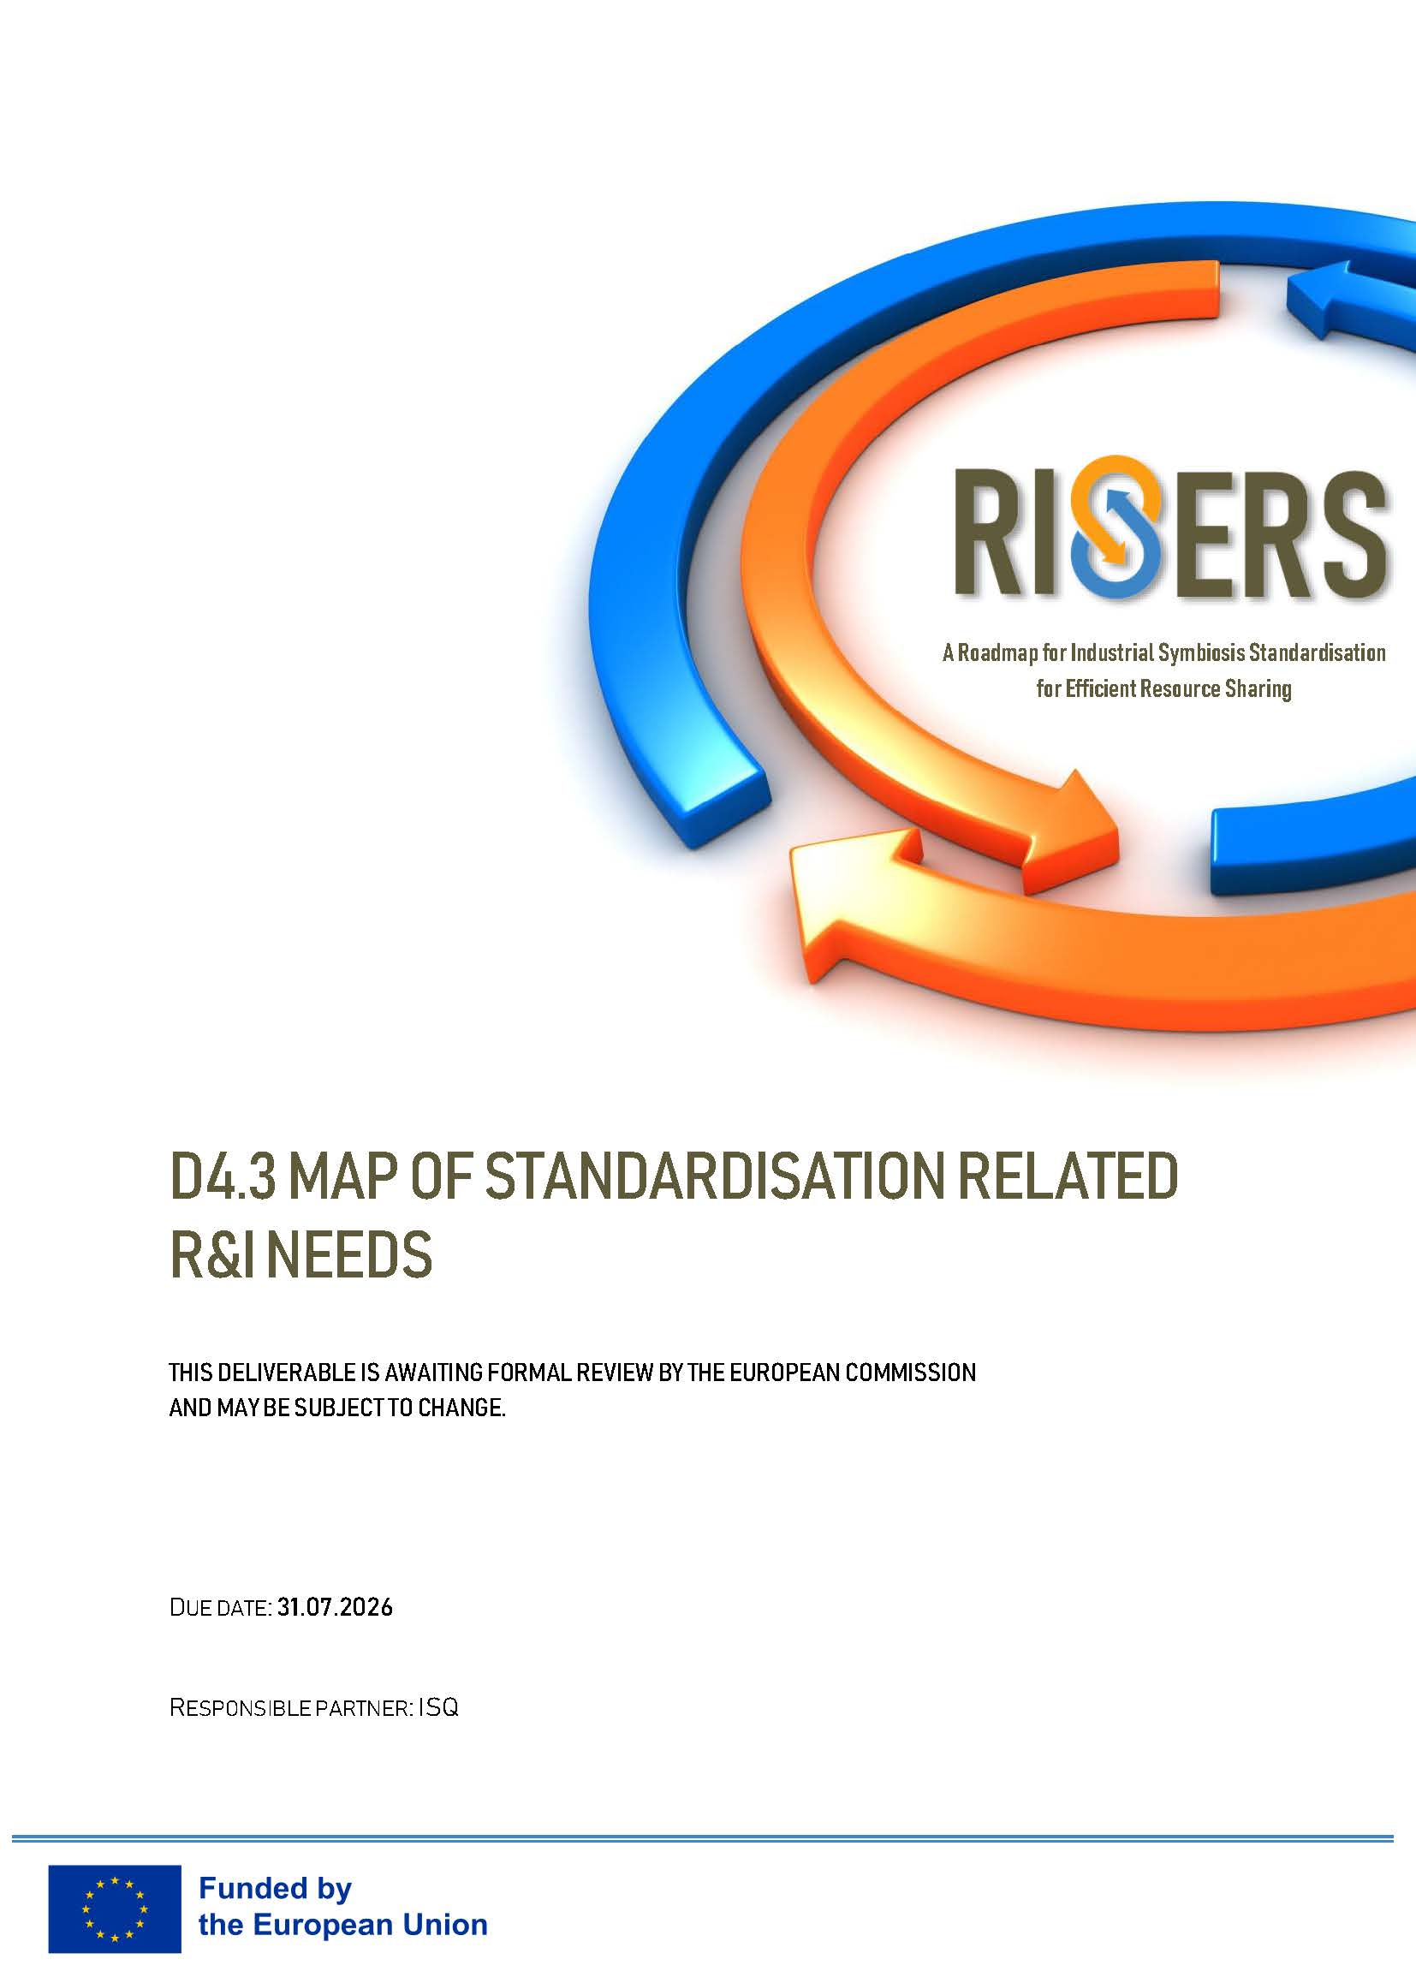


RISERS Reports in support of IS stadardisation needs

Slide 37
Step 2 Consider interdependencies between different R&I needs
Systems thinking approach
Sector-specific needs
System level needs
Horizontal needs
Notes:
This step checks whether that need depends on other horizontal, sector-specific or system-level needs. The project should check whether the identified R&D need depends on, or is connected with, needs at another level. Horizontal, sector-specific and system-level needs should not be treated as isolated categories.
Second-life batteries
Sector-specific need: reliable methods for assessing battery State of Health, Remaining Useful Life and suitability for second-life applications.
Horizontal need: common data fields, terminology, traceability information and interoperable data structures for describing battery condition and history.
System-level need: governance and information-sharing arrangements that allow relevant battery data to be accessed and used across organisations.
Waste heat
Sector-specific need: methods for measuring and assessing waste-heat availability, temperature characteristics and recovery performance in relevant industrial applications.
Horizontal need: common descriptors, measurement boundaries and interoperable energy-data structures that allow heat data to be compared and exchanged.
System-level need: infrastructure and spatial-planning methodologies for assessing whether heat producers and users can be technically and geographically connected.
Secondary materials / slags
Sector-specific need: material-specific sampling, characterisation and test methods for assessing the quality, durability and environmental safety of slags or other secondary materials in defined applications.
Horizontal need: common terminology, resource descriptors, quality information and assessment approaches that allow results to be compared across suppliers and applications.
System-level need: rules and practices related to resource status, liability, contracting and information sharing that affect whether the secondary material can be accepted and used across organisational boundaries.
Digital industrial-symbiosis platforms
Sector-specific need: sector- or material-specific descriptors needed to represent particular resource streams accurately.
Horizontal need: common data models, semantics, identifiers and interoperability requirements enabling exchange between digital systems.
System-level need: governance arrangements for data access, confidentiality, responsibilities and long-term information sharing between participating organisations.
So when designing IS R&D, the links between needs are themselves important.

Slide 38
Step 2 Consider interdependencies between different R&I needs: examples
Use of waste heat
Second-life batteries
Horizontal need: common descriptors, measurement boundaries and interoperable energy-data structures that allow heat data to be compared and exchanged.
Horizontal need: common data fields, terminology, traceability information and interoperable data structures for describing battery condition and history.
Sector-specific need: methods for measuring and assessing waste-heat availability, temperature characteristics and recovery performance in relevant industrial applications.
System-level need: infrastructure and spatial-planning methodologies for assessing whether heat producers and users can be technically and geographically connected.
Sector-specific need: reliable methods for assessing battery State of Health, Remaining Useful Life and suitability for second-life applications
System-level need: governance and information-sharing arrangements that allow relevant battery data to be accessed and used across organisations.
Notes:
This step checks whether that need depends on other horizontal, sector-specific or system-level needs. The project should check whether the identified R&D need depends on, or is connected with, needs at another level. Horizontal, sector-specific and system-level needs should not be treated as isolated categories.
Second-life batteries
Sector-specific need: reliable methods for assessing battery State of Health, Remaining Useful Life and suitability for second-life applications.
Horizontal need: common data fields, terminology, traceability information and interoperable data structures for describing battery condition and history.
System-level need: governance and information-sharing arrangements that allow relevant battery data to be accessed and used across organisations.
Waste heat
Sector-specific need: methods for measuring and assessing waste-heat availability, temperature characteristics and recovery performance in relevant industrial applications.
Horizontal need: common descriptors, measurement boundaries and interoperable energy-data structures that allow heat data to be compared and exchanged.
System-level need: infrastructure and spatial-planning methodologies for assessing whether heat producers and users can be technically and geographically connected.
Secondary materials / slags
Sector-specific need: material-specific sampling, characterisation and test methods for assessing the quality, durability and environmental safety of slags or other secondary materials in defined applications.
Horizontal need: common terminology, resource descriptors, quality information and assessment approaches that allow results to be compared across suppliers and applications.
System-level need: rules and practices related to resource status, liability, contracting and information sharing that affect whether the secondary material can be accepted and used across organisational boundaries.
Digital industrial-symbiosis platforms
Sector-specific need: sector- or material-specific descriptors needed to represent particular resource streams accurately.
Horizontal need: common data models, semantics, identifiers and interoperability requirements enabling exchange between digital systems.
System-level need: governance arrangements for data access, confidentiality, responsibilities and long-term information sharing between participating organisations.
So when designing IS R&D, the links between needs are themselves important.

Slide 39
Step 3 Formulate the potential IS standardisation challenge
What is currently defined or interpreted differently?
What cannot currently be compared?
What cannot interoperate?
What cannot be measured, tested or characterised consistently?
Where are quality, performance or acceptance criteria missing or inconsistent?
Where is the available evidence insufficient to support a common approach?
What prevents the approach from being replicated or transferred beyond the original setting?
Does the problem occur beyond one project or company?
Is the problem linked to other horizontal, sector-specific or system-level R&I needs identified in the previous step?
Not every industrial symbiosis challenge requires standardisation
A standardisation-relevant challene may occur where different actors need a sufficiently common approach for example to :
communicate, compare results,
transact resources or exchange data,
assess performance
reproduce an approach in different settings.
Notes:
At this stage the gap is provisional. You are formulating the issue that needs to be checked against the existing landscape.A company may have difficulties finding a suitable local user for a secondary resource. This is mainly a market-matching or business-development challenge, not necessarily a standardisation problem. However, if potential users cannot compare the resource because suppliers describe its composition and quality differently, then a standardisation-related need may exist for common descriptors or characterisation methods.

Slide 40
Step 4 Analyse the current standardisation landscape
Where does the project sit in relation to the existing standardisation landscape?
What is missing?
How the identified R&I need relates to existing and ongoing standardisation work?
existing European and international standards;
standards under development or revision;
relevant Technical Committees and Working Groups;
existing CEN Workshop Agreements (CWAs), Technical Specifications and Technical Reports;
relevant standardisation roadmaps or work programmes;
existing test, measurement and characterisation methods;
classification schemes, terminology, data models and interoperability specifications;
public deliverables, technical reports and methods from relevant completed or ongoing R&I projects;
results of previous pilot, demonstration or validation activities that may already address part of the standardisation gap;
relevant regulatory requirements.
Baseline definition
Review the standardisation landscape early and monitor it throughout the project as standards and related activities evolve
Notes:
Before defining what the project should develop, we need to understand what already exists.
This means looking not only at published standards, but also at standards under development, relevant Technical Committees and Working Groups, and other formal standardisation documents such as CWAs, Technical Specifications and Technical Reports.
We should also look beyond formal standardisation. Relevant public deliverables and technical reports from completed or ongoing R&I projects may already contain methods, datasets, test approaches or validation results that address part of the problem. These project outputs are not standards, but they can help us avoid duplication and show where the remaining gap actually is.
The RISERS Interactive Standards Mapping can be used as a starting point to identify potentially relevant CEN, CENELEC, ISO and IEC Technical Committees by sector and resource area.
This analysis should not be treated as a one-off exercise. An initial scan should already be done during proposal preparation, a more detailed review at project start, and the landscape should be updated during implementation as the technical work and relevant standardisation activities evolve.
The key questions are: What is already covered? What is currently being developed? What has already been tested or proposed in previous projects? And where does a genuine gap remain?
At this stage, we are not yet choosing the standardisation pathway. The purpose is to establish the baseline and understand what the R&D project needs to take into account before defining its contribution.
Possible outcomes may be:
the issue is already sufficiently covered by existing standards;
relevant standardisation work is ongoing and the project should align with or potentially contribute to it;
an existing standard does not fully address the identified need;
a genuine gap remains and further R&D is needed before standardisation can progress;
no relevant standardisation activity currently exists.

Slide 41
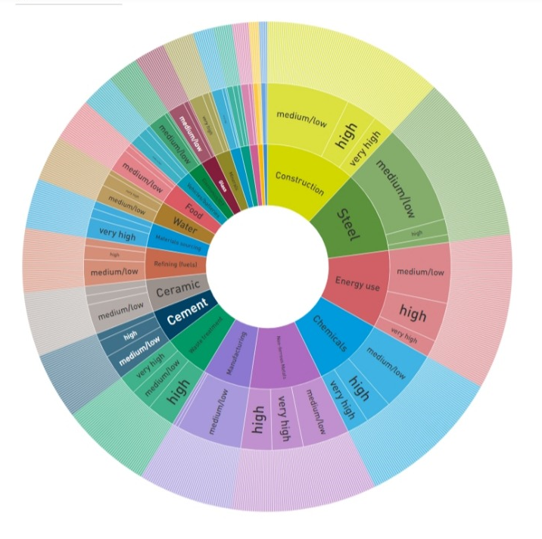

RISERS Tool for IS Stadardisation Landscape
Mapping of Technical Committees to priority resources and sectors
Maps European and international Technical Committees against key Industrial Symbiosis sectors and indicates their estimated relevance, helping projects identify potentially relevant TCs for further standardisation landscape analysis.

Slide 42
Step 5 Define what R&I should provide
Direct contributions to standardisation
Outputs that could be transferred into existing or future standardisation work e.g:
terminology and definitions;
classifications and resource descriptors;
measurement, sampling, test or characterisation methods;
KPIs and assessment methodologies;
quality, performance or acceptance criteria;
data requirements and interoperability specifications;
traceability or chain-of-custody requirements;
verification or conformity-assessment approaches;
technical requirements or protocols.
Standardisation-supporting outputs
Outputs that create the technical and evidential basis needed for standardisation e.g:
representative or reference datasets;
comparative analyses of existing methods or approaches;
reference test cases or benchmark cases;
validation protocols or test protocols;
interoperability test specifications or reference scenarios;
documented operating ranges, boundary conditions and limitations;
technical reports consolidating pre-normative research results;
structured evidence packages supporting future standardisation work.
Enabling frameworks and conditions relevant to standardisation
Outputs that do not necessarily become technical standards themselves, but may enable their development, application or uptake e.g.:
competence frameworks and training requirements;
common governance principles;
contractual or information-sharing frameworks;
common approaches to roles, responsibilities or liability;
common criteria for infrastructure or spatial-planning assessment;
organisational or institutional arrangements supporting implementation;
evidence informing regulatory alignment.
What the project produces?
Notes:
what the project produces
At this stage, we have already identified the R&D need, considered how it links with other needs, defined the preliminary standardisation-related gap, and checked the existing standardisation landscape.
Now we need to decide what the R&D project should actually produce.
It is useful to distinguish three types of outputs.
The first are direct contributions to standardisation. These are results that could potentially feed into existing or future standardisation work, such as terminology, classifications, test methods, KPIs, quality criteria, interoperability requirements or technical protocols.
The second are standardisation-supporting outputs. These do not necessarily become part of a standard themselves, but they provide the evidence needed for standardisation to progress. Examples include datasets, method comparisons, validation studies, interoperability trials or evidence showing that an approach works across different sites, companies or use cases.
The third group concerns enabling frameworks and conditions relevant to standardisation. These may include competence frameworks, governance or contractual approaches, information-sharing arrangements or other organisational conditions that help make standardisation usable and implementable in practice.
The important point is that not every useful R&D result needs to become a standard. Some results may provide direct technical content for standardisation, some provide the evidence base, and some create the conditions needed for standards to be developed or applied effectively.
The project should therefore formulate its intended contribution as concretely as possible, for example:
“The project will develop, test and validate…”
This is much more useful than simply saying that the project will “support standardisation”.

Slide 43
Step 6 Identify & Engage the right actors
Industrial users and problem owners
They help define whether the proposed common approach responds to a real industrial need.
resource providers and users;
companies applying the resource, technology or method;
technology providers;
data-platform providers.
Main role: define requirements, provide use cases, samples, operating conditions and practical feedback. (beneficiaries)
Intermediaries and representative organisations
They connect individual projects with wider industrial communities and help test whether the proposed approach is transferable.
industrial symbiosis facilitators;
industry associations;
clusters and industrial networks, technology parks
Main role: represent broader user needs, identify additional use cases, mobilise companies and support consensus building.
Actors
Standardisation actors
They help ensure that the R&D work is aligned with existing standardisation and can later be transferred appropriately.
Standardisation Bodies;
relevant Technical Committees and Working Groups;
standardisation experts.
Main role: advise on existing work, terminology and procedures; help avoid duplication; and identify opportunities for future contribution to standardisation, enable liaison, adapt the work (early adapters)
Regulatory and enabling actors
They are important where the standardisation-related issue interacts with regulation, permitting, resource status, public procurement or other framework conditions.
regulators and competent authorities;
relevant public authorities;
policy makers, where appropriate.
Main role: clarify regulatory constraints, compatibility and potential links between standards and policy/regulation
Knowledge, testing and validation actors
They help generate and assess the technical evidence needed.
research organisations;
laboratories and testing bodies;
assessment / verification bodies;
technical and data experts.
Main role: develop methods, generate evidence, test repeatability or interoperability, and support validation.

Slide 44
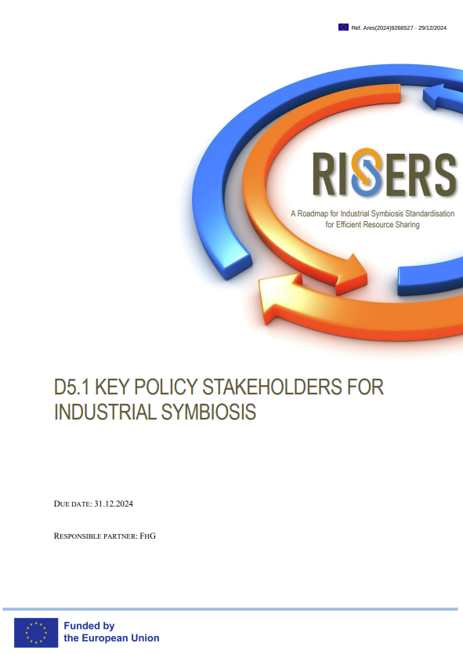

RISERS Report on IS Policy Stakeholders

Slide 45
Examples of stakeholders engagement methods
SYSTEM MAPPING
Understand actors, flows, interfaces and interdependencies
Facilitated mapping workshops; stakeholder interviews; actor/network maps; resource-flow mapping; value-chain mapping
CO-DESIGN
Jointly define problems, R&D needs and priorities
Co-design workshops; focus groups; problem-framing session, priority-setting exercises; stakeholder interviews
CO-CREATION
Jointly develop methods, approaches and solutions
Co-creation workshops; thematic working groups; challenge labs; joint development sessions; collaborative prototyping; expert roundtables
LIVING LABS / COLLABORATIVE TESTING
Test and validate results with stakeholders in real-world settings
Living labs; pilot demonstrations; field trials; collaborative testing campaigns; user/practitioner observation; feedback sessions; cross-sector case studies
DELPHI / CONSENSUS METHODS
Build convergence around priorities, requirements and evidence
Delphi questionnaires in several rounds; expert panels; structured surveys; ranking/scoring exercises; consensus workshops;
Create a structured interface between R&I actors and relevant standardisation actors
Joint R&I–TC/WG workshops; technical briefings to TCs/WGs; project liaison arrangements; participation of standardisation experts in project working groups; targeted expert meetings; structured review/comment rounds
STRUCTURED LIAISON / KNOWLEDGE BROKERAGE

Slide 46
Step 7 Plan the evidence needed
For KPIs and assessment methodologies
clearly defined scope, boundaries and calculation rules;
availability and quality of underlying data;
comparison with existing approaches;
sensitivity and robustness analysis;
validation across relevant cases.
What evidence shows that the output is relevant, concrete, evidence-based & transferable ?
No single evidence package for standardisation related R&I contributions
Evidence requirements depend on what is being proposed for standardisation
Rule : First define intendent contribution then build appropriate evidence arround it
For terminology, definitions and classification
review and comparison of existing approaches;
evidence from relevant use cases;
consistency across relevant sectors or applications;
stakeholder/expert validation;
identification and resolution of ambiguities or conflicting definitions.
For sampling, measurement, test and characterisation methods
representative samples or datasets;
repeatability and reproducibility;
measurement uncertainty;
comparison with existing/reference methods;
inter-laboratory or multi-site validation, where appropriate.
For quality, performance or acceptance criteria
evidence linking the proposed criteria to intended use;
data covering relevant variability;
justification of thresholds, classes or limits;
validation under relevant application conditions
For data structures and interoperability
testing across different systems or platforms;
consistent interpretation of data fields and descriptors;
data completeness and quality;
interoperability testing;
validation with relevant users and use cases.

Slide 47
Step 8 Assess transferability and wider applicability
different installations
technologies
operating conditions
resource qualities
within one sector
across sectors, where relevant
different IS use cases
Across technical
contexts
Across sectors / applications
R&I
contribution
different companies
different users
different IS partnerships
different platforms
information systems
data environments (interoperability)
Across digital systems
Across organisations
Across regulatory / regional contexts
different regions
national frameworks
organisational settings
Transferability dimensions depend on the type of R&I contribution

Slide 48
Step 8 Assess transferability and wider applicability
Has the approach been demonstrated beyond a single project, company or pilot?
Can it be applied by different organisations or users?
Can it be used across different installations, technologies or operating conditions, where relevant?
Can it accommodate different qualities or types of resource streams?
If the contribution is sector-specific, can it be applied across different companies or use cases within that sector?
If the contribution is horizontal, can it be applied across different sectors or industrial-symbiosis applications?
If it concerns data or digital systems, can it work across different platforms or information systems?
Is its applicability dependent on a specific regulatory, regional or organisational context?
Which elements are broadly transferable, and which remain context-specific?
Are the limitations and conditions for wider application clearly defined?
A result that works in one industrial symbiosis pilot is not automatically suitable as a common approach
Horizontal contributions → usually broader applicability
Sector-specific contributions → applicable beyond one company/pilot in the sector
System-level contributions → consider different organisational, territorial or regulatory contexts
Notes:
A successful industrial symbiosis pilot is important, but success in one site does not automatically provide a basis for a common approach.
The research therefore needs to ask how far the result travels.
Can another company use it? Does it work with different qualities of the resource stream? Can it operate with another digital platform? Does it depend strongly on one national regulatory context?
The required breadth will depend on the type of R&D contribution. Horizontal contributions should normally demonstrate relatively broad applicability, while a sector-specific contribution can legitimately remain within its sector — but it should still go beyond one company or one pilot

Slide 49
Step 9 Link the R&D contribution to possible standardisation route
What determines the standardisation route?
What standardisation action is realistic?
01
Maturity of evidence
Is the result sufficiently robust and validated?
Consider a standardisation pathway after the need, intended ouput, evidence requirements and wider applicability have been assessed
02
Existing standardisation work
Is a relevant TC/WG already working on the topic?
03
Existing standard
Should an existing standard be improved or revised?
04
Need for new work
Does the result justify a new standardisation activity?
Notes:
he final section brings us back to the standardisation pathway.
The toolkit explicitly says that this should be considered after the need, the R&D result and the evidence have been defined.
Sometimes further pre-normative R&D will still be needed.
Sometimes a useful common approach exists but formal standardisation is not yet justified, and a guidance document or reference methodology may be more appropriate.
A sufficiently mature innovative result may potentially lead to a CEN Workshop Agreement.
And if relevant standardisation work already exists, the best route may be to provide technical input to an existing Technical Committee or Working Group.
The toolkit gives examples from European R&I projects, including SHAREBOX, FISSAC and ECO-BINDER

Slide 50
Step 9 Link the R&D contribution to possible standardisation route
Situation |  | Possible next step
Evidence remains incomplete or transferability has not yet been demonstrated
A useful common approach exists, but formal standardisation is not yet justified |  | Develop guidance, a reference methodology or another common technical document
Relevant standardisation work is already underway |  | Contribute to the relevant TC/WG, through individual project partners or stakeholders, or through project liaison (project becomes a Liaison Organization)
An existing standard does not adequately address the identified need |  | Provide technical evidence and proposals that may support revision or modification of the existing standard through the relevant TC/WG
A standardisation need is identified and no suitable standard exists, while the result is sufficiently mature for standardisation |  | Choose the appropriate route: propose/recommend new standardisation work to the relevant TC, or initiate a CEN/CENELEC Workshop Agreement (CWA) where a rapid consensus-based deliverable is more appropriate
Further pre-normative R&I
Notes:
he final section brings us back to the standardisation pathway.
The toolkit explicitly says that this should be considered after the need, the R&D result and the evidence have been defined.
Sometimes further pre-normative R&D will still be needed.
Sometimes a useful common approach exists but formal standardisation is not yet justified, and a guidance document or reference methodology may be more appropriate.
A sufficiently mature innovative result may potentially lead to a CEN Workshop Agreement.
And if relevant standardisation work already exists, the best route may be to provide technical input to an existing Technical Committee or Working Group.
The toolkit gives examples from European R&I projects, including SHAREBOX, FISSAC and ECO-BINDER

Slide 51
Key takeaways
Consider standardisation early as a potential exploitation pathway.
If an IS R&I result may contribute to standardisation, this should influence what the project develops, tests and validates from the outset.
Start from a real IS need.
Standardisation-relevant R&I should address a problem that requires a common approach beyond one project or organisation.
Check the standardisation landscape early — and keep monitoring it.
Existing standards, ongoing TC/WG work and emerging activities determine where the project can contribute.
Define a concrete contribution.
R&I results become useful for standardisation when they can be translated into methods, terminology, classifications, criteria, data requirements or other clearly defined outputs.
Generate evidence that the contribution is reliable and transferable.
The type of evidence depends on the result, but it should show that the approach works beyond a single project setting.
Engage the right stakeholders throughout the process.
Industry, researchers, testing bodies, regulators, facilitators and standardisation actors all contribute different types of knowledge and validation.
Choose the standardisation route according to maturity and context.
The next step may be further pre-normative R&I, contribution to ongoing TC/WG work, revision of an existing standard, or new standardisation work including a CWA.

Slide 52






Thank you
James Woodcock
International Synergies Ltd
WWW.RISERS-PROJECT.EU

