Slide 1

The case study of a transport firm and European Green Deal
Authors:
Krzysztof Wyszogrodzki
Adrianna Szeliga

Slide 2

Introduction of a transport firm
In this case study the main focus is put on a transport firmcalled Fast Track Delivery. They transport all kinds of goods and packages. It is located in the city of Kraków.
Image 1. Logo of Fast Track Delivery created by Chat GPT

Slide 3
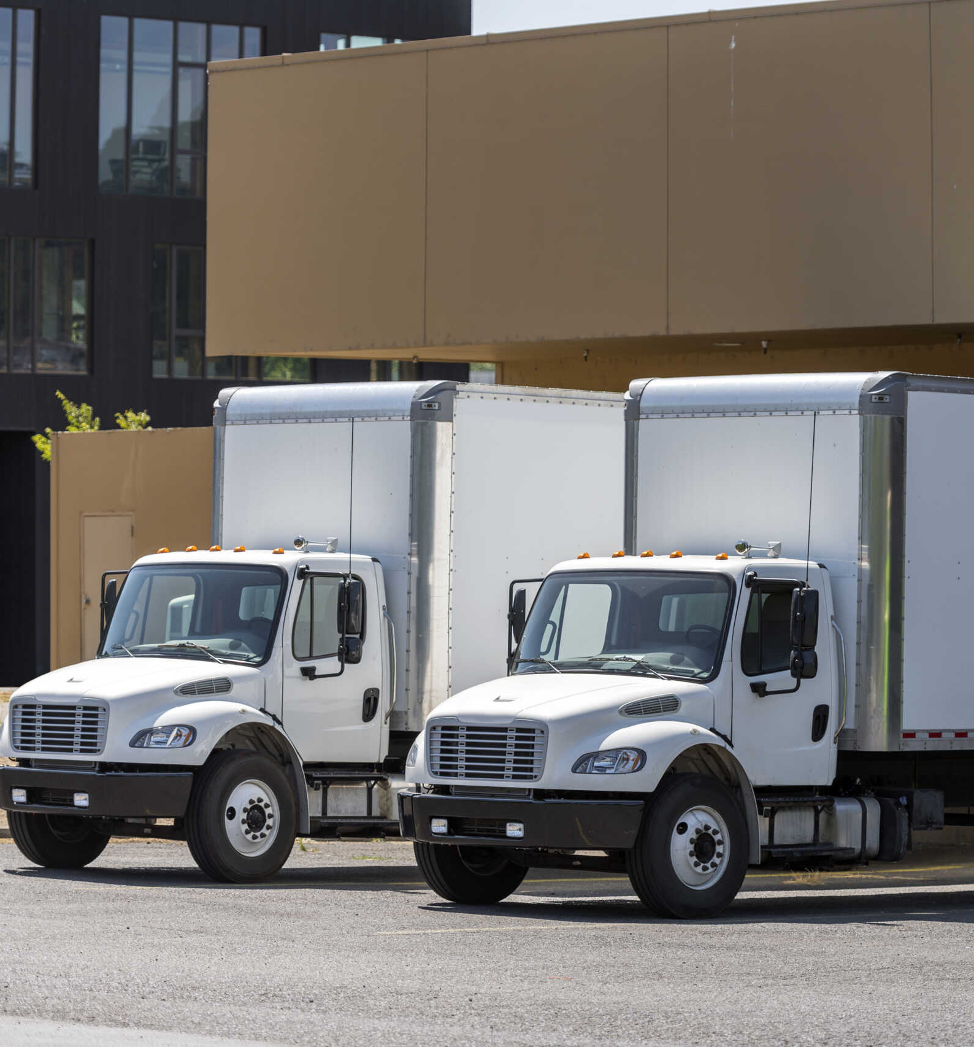
Size of the fleet
The company has a fleet of 12 delivery trucks. It contains:
7 box trucks running on petrol produced in 2005
5 box trucks also running on petrol produced in 2000
1 box truck running on diesel produced in 2009
Image 2. Trucks, https://otdw.net/2022/03/30/business-advantages-to-3pl-box-truck-deliveries/

Slide 4
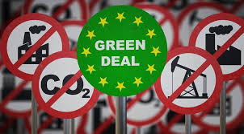
The main problem
The main problem of this imaginary company is the new regulations of European Green Deal, especially the part that contains the new regulations of public transport in city centers. The owner is afraid that he would need to quickly switch to new trucks to be able to still operate in this area.
Next prat will focus on European Green Deal – what it is, it's main objectives and benefits of it.
Image 3. https://en.bia-bg.com/news/view/29664/

Slide 5

What is European Green Deal
The European Green Deal is the European Union's long-term strategy to make Europe's economy more sustainable while addressing climate change, protecting biodiversity, and improving people's quality of life. It was presented by the European Commission in 2019.
Its main goal is for the European Union to become climate neutral by 2050, meaning that it will remove or offset as much greenhouse gas from the atmosphere as it emits.
Image 4. https://eufreshness.eu/index.php/green-deal

Slide 6
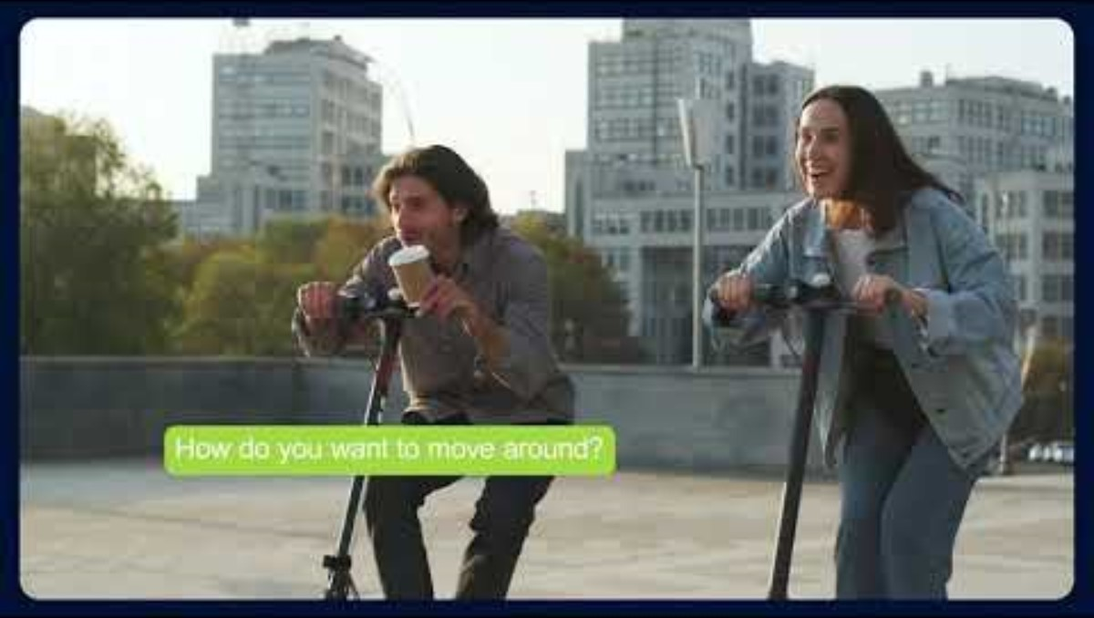
https://www.youtube.com/watch?v=H37grur6HaU

Slide 7
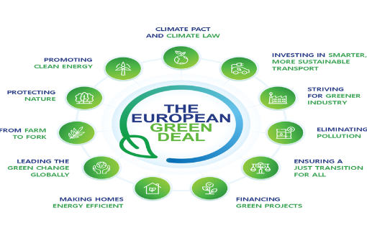
Main objectives
Reducing greenhouse gas emissions by at least 55% by 2030 (compared with 1990 levels) and reaching net-zero emissions by 2050.
Transitioning to clean energy, including greater use of renewable sources such as wind and solar power.
Improving energy efficiency in buildings, industry, and transport.
Promoting sustainable transport, including electric vehicles, rail transport, and cleaner fuels.
Supporting a circular economy, where products are reused, repaired, and recycled to reduce waste.
Protecting biodiversity by restoring ecosystems, expanding protected areas, and reducing pollution.
Encouraging sustainable agriculture through initiatives such as the Farm to Fork Strategy, which aims to make food systems healthier and more environmentally friendly.
Reducing pollution in air, water, and soil through stricter environmental standards.
Image 5. https://www.researchgate.net/figure/European-Green-Deal-Source-EU-ASEAN-2022-EC-2019_fig3_367157948

Slide 8
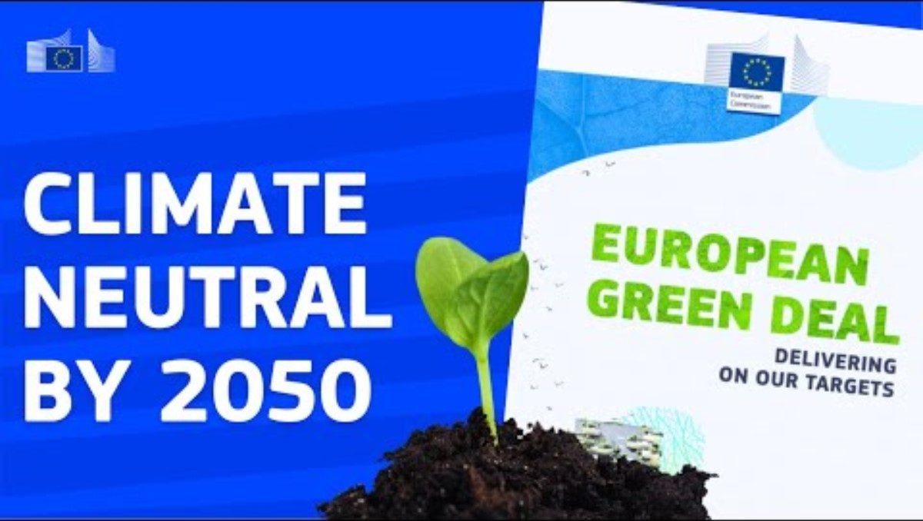
https://www.youtube.com/watch?v=e-OiG6p2dHQ

Slide 9
Benefits of European Green Deal
Benefits of European Green Deal
Supporters argue that the European Green Deal can:
Help combat climate change.
Improve air and water quality.
Create new jobs in renewable energy and green industries.
Reduce dependence on imported fossil fuels.
Improve public health through lower pollution.

Slide 10
Challenges of European Green Deal
Challenges of European Green Deal
The Green Deal also faces challenges:
High upfront costs for governments, businesses, and households.
Economic adjustments for industries that rely on fossil fuels.
Concerns from some farmers and manufacturers about increased regulations and costs.
The need to balance environmental goals with economic competitiveness and energy security.

Slide 11
The main point of worry
The main point of worry to the owner of Fast Track Delivery is not all parts of the European Green Deal. He agrees with most of the points of it. He is worried about the new regulations that are coming with the European Green Deal, in particular about the LEZ - Low Emission Zones.
This next part is focused on explaining what are the LEZ are. We will explain the regulations and standards that are contained in them, as also the reaction of the population about them.

Slide 12
What is a Low Emission Zone
In Poland, Low Emission Zones are called Clean Transport Zones (Polish: Strefa Czystego Transportu – SCT). They are established by local governments under Polish law to reduce air pollution from road traffic, particularly in large cities.
Clean Transport Zones (SCT) are a local tool used to achieve the goals of the European Green Deal, which aims for climate neutrality by 2050. By restricting the entry of the highest-emitting vehicles, these zones improve urban air quality and accelerate the transition to sustainable transport.
Image 6. https://pl.wikipedia.org/wiki/Strefa_czystego_transportu

Slide 13
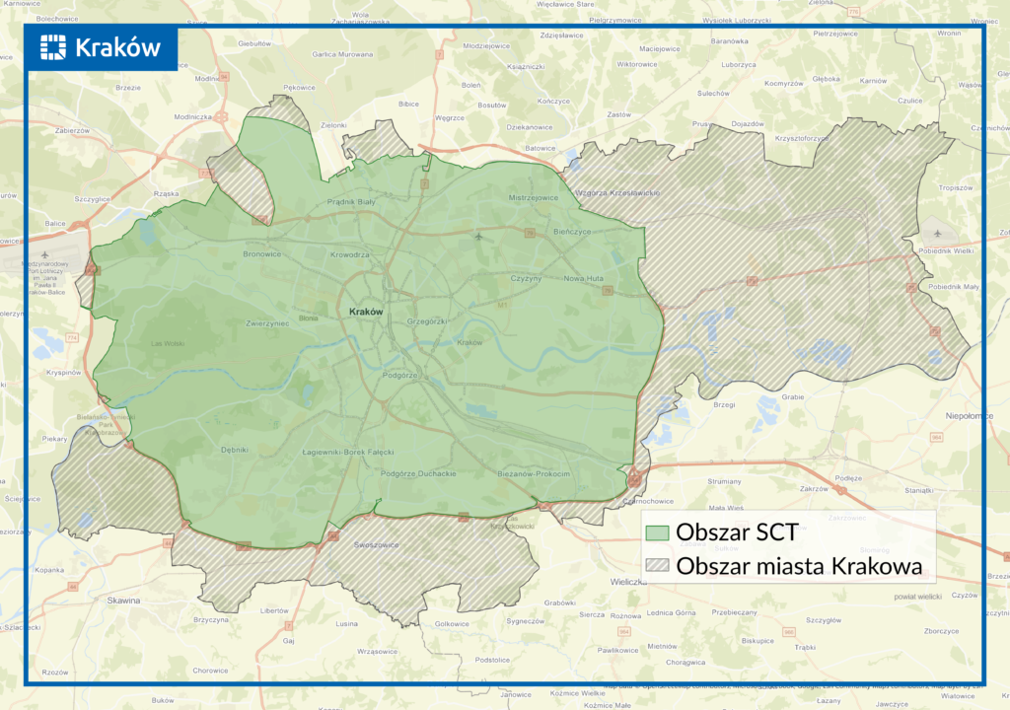
Where are they in Poland?
Warsaw was the first Polish city to introduce a Clean Transport Zone. It came into force in July 2024 and is being expanded gradually over several years.
Kraków has also been working toward implementing a Clean Transport Zone, although its plans and timeline have changed following public consultation and legal developments. This is the main reason why the owner of the company that we are analyzing is worried about his fleet.
Image 8. https://ztp.krakow.pl/wszystkie-aktualnosci/sct/zapoznaj-sie-z-nowym-projektem-uchwaly-nowej-strefy-czystego-transportu.html

Slide 14
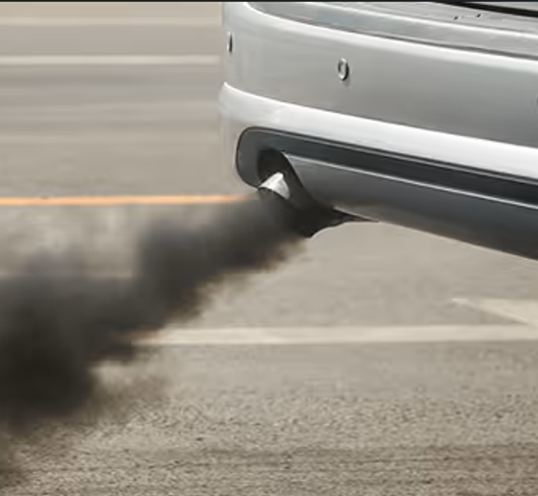
The point of LEZ
Restricts the entry of vehicles that do not meet minimum emission standards.
Applies mainly to older petrol and diesel vehicles with higher emissions.
Is monitored using road signs and, in some cases, camera systems.
May provide exemptions for certain groups, such as emergency services or residents during transition periods, depending on local regulations.
Image 7. https://www.natewade.com/service/what-the-color-of-visible-tailpipe-emissions-means/

Slide 15
Objectives of LEZ
Improve air quality in urban areas.
Reduce emissions of nitrogen oxides (NOₓ) and particulate matter (PM).
Protect public health.
Encourage the use of cleaner vehicles, public transport, cycling, and walking.
Help Poland meet EU air-quality and climate requirements.

Slide 16
Benefits and challenges to Low Emission Zones
Benefits
Cleaner air and fewer pollution-related illnesses.
Reduced vehicle emissions in city centres.
Increased use of low-emission transport.
Better quality of life for residents.
Challenges
Costs for owners of older vehicles.
Concerns from businesses and commuters.
The need for good public transport alternatives.
Public debate over fairness and the pace of implementation.

Slide 17
Main standards included into the LEZ
Standard | Year introduced (new cars) | Typical requirement
Euro 1 | 1992 | First EU emission limits for passenger cars.
Euro 2 | 1996 | Reduced carbon monoxide (CO) and hydrocarbons.
Euro 3 | 2000 | Stricter limits on nitrogen oxides (NOₓ).
Euro 4 | 2005 | Further reductions in NOₓ and particulate matter (PM).
Euro 5 | 2009 | Significant reduction in particulate emissions from diesel vehicles; diesel particulate filters became common.
Euro 6 | 2014 | Very strict limits on NOₓ emissions from diesel vehicles and lower overall pollutant emissions.

Slide 18
Euro 1
Euro 1 is the first European Union vehicle emission standard, introduced in 1992. It set basic limits for harmful pollutants from new cars, including carbon monoxide (CO),hydrocarbons (HC), and nitrogen oxides (NOₓ). Its introduction required most petrol cars to use catalytic converters and led to the widespread use of unleaded fuel. Euro 1marked the beginning of EU efforts to reduce air pollution from transport and became the foundation for later, stricter standards.

Slide 19
Euro 2
The Euro 2 emissions standard was introduced in 1996 and represented another step toward reducing harmful pollutants produced by vehicles. During this period, manufacturers began widely using catalytic converters and more advanced engine management systems. Cars meeting the Euro 2 standard emitted lower levels of carbon monoxide and hydrocarbons than Euro 1 vehicles, but by today’s standards their environmental impact was still relatively high. Diesel engines, in particular, continued to produce significant amounts of soot and nitrogen oxides.

Slide 20
Euro 3
The Euro 3 standard came into force in 2000 and introduced significantly stricter emission limits. Vehicle manufacturers were required to improve fuel injection systems and electronic engine controls to reduce harmful exhaust emissions more effectively. More rigorous testing procedures were also introduced, providing a more realistic assessment of vehicle emissions. As a result, Euro 3 vehicles were considerably cleaner than those built to previous standards.

Slide 21
Euro 4
Introduced in 2005, the Euro 4 standard focused on further reducing nitrogen oxide and particulate matter emissions, especially from diesel engines. To comply with the new requirements, manufacturers increasingly adopted Exhaust Gas Recirculation (EGR) systems, which lowered combustion temperatures and reduced harmful emissions. Particulate filters also began appearing in many diesel vehicles, although they were not yet as widespread as they would become later. Euro 4 vehicles remain common on roads today.

Slide 22
Euro 5
The Euro 5 standard was introduced in 2009 and marked a major advancement, particularly for diesel-powered vehicles. The most significant change was a substantial reduction in allowable particulate matter emissions, making Diesel Particulate Filters (DPF) virtually mandatory in new diesel cars. Emission limits for nitrogen oxides and other pollutants were also tightened. As a result, Euro 5 vehicles produce far less soot than older models, although they still do not achieve the low emission levels required under Euro 6.

Slide 23
Euro 6
The Euro 6 standard came into effect in 2014 and is one of the strictest emissions regulations for internal combustion engine vehicles. Its primary objective was to dramatically reduce nitrogen oxide emissions from diesel engines, which had been a major environmental concern. To meet these requirements, manufacturers introduced advanced exhaust after-treatment technologies, including Selective Catalytic Reduction (SCR) systems that use AdBlue. Later versions of the standard, such as Euro 6d, introduced Real Driving Emissions (RDE) testing to ensure vehicles met emission limits under actual road conditions rather than only in laboratory tests. As a result, Euro 6 vehicles are among the cleanest conventional combustion-engine cars available today.

Slide 24
Euro 7
Euro 7 is the next generation of European vehicle emission standards and is designed to further reduce the environmental impact of both passenger cars and commercial vehicles. Unlike previous standards, Euro 7 will not only focus on exhaust emissions but will also regulate non-exhaust pollutants such as brake dust and tire particle emissions. The standard will introduce stricter testing procedures to ensure vehicles maintain low emissions throughout a much longer portion of their service life. In addition, it will set requirements for the durability and performance of batteries in electric and hybrid vehicles. The overall goal of Euro 7 is to improve air quality and ensure that vehicles remain environmentally friendly under real-world driving conditions for many years.

Slide 25
Reaction of population on LEZ and on European Green Deal
Most Poles view the LEZ and European Green Deal negatively, with public opinnion polls dominated by concerns over rising energy costs and the impact of environmental regulations. According to the CBOS (Centrum Badania Opinii Publicznej) survey the European Green Deal evokes negative associations among 52% of surveyed, and positive ones only among 14%.
Farmers are the most reluctant group, with 84% of respondents in this category associating the Green Deal negativly.
Source:
https://www.pap.pl/aktualnosci/co-polacy-sadza-o-zielonym-ladzie-sondaz-cbos

Slide 26
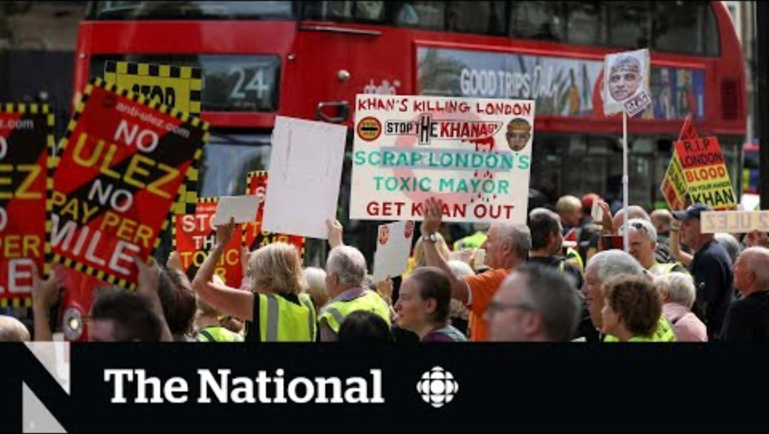
https://www.youtube.com/watch?v=uitSFHT2Wbw

Slide 27

Ways to check if you need to worry
There are ways to check if your car can or can not get into the LEZ. There are special online spaces as web pages dedicated to the mater. Everyone can check if their car is able to drive into the Low Emission Zones. If you can do it, you can also apply for a special pass to do it legally and don't have to worry about controls.
https://sct.zdmk.krakow.pl/#/application
Image 9. https://www.krakow.pl/300895,artykul,strefa-czystego-transportu-w-krakowie-–-praktyczny-przewodnik.html

Slide 28
Summary
The presentation is a case study of a Kraków-based delivery company, “Fast Track Delivery,” operating a fleet of 12 older petrol and diesel trucks (2000–2009). It examines how the European Green Deal and Low Emission Zones (Clean Transport Zones in Poland) may restrict access to city centres and force costly fleet upgrades.It explains the European Green Deal as the EU’s plan to reach climate neutrality by 2050 through emission reductions, renewable energy, energy efficiency, and sustainable transport. It also highlights LEZs in cities like Warsaw and planned zones in Kraków, which aim to improve air quality by limiting high-emission vehicles.The presentation briefly covers Euro emission standards and notes growing public concern in Poland about the financial impact of these regulations.
Taking into consideration everything said above, the owner of the Fast Track Delivery should check the webside to know exactly if his fleet of box trucks are able to move freely in the LEZ.

Slide 29
Bibliography
https://sct.zdmk.krakow.pl/#/application
https://www.krakow.pl/300895,artykul,strefa-czystego-transportu-w-krakowie-–-praktyczny-przewodnik.html
https://commission.europa.eu/strategy-and-policy/priorities-2019-2024/european-green-deal_pl
https://www.youtube.com/watch?v=uitSFHT2Wbw
https://www.pap.pl/aktualnosci/co-polacy-sadza-o-zielonym-ladzie-sondaz-cbos
https://pl.wikipedia.org/wiki/Strefa_czystego_transportu
https://ztp.krakow.pl/wszystkie-aktualnosci/sct/zapoznaj-sie-z-nowym-projektem-uchwaly-nowej-strefy-czystego-transportu.html
https://www.youtube.com/watch?v=e-OiG6p2dHQ
https://www.youtube.com/watch?v=H37grur6HaU
https://eufreshness.eu/index.php/green-deal
https://www.natewade.com/service/what-the-color-of-visible-tailpipe-emissions-means/
https://www.natewade.com/service/what-the-color-of-visible-tailpipe-emissions-means/

