Slide 1



DIGITAL STANDARDS FOR A GREEN FUTURE
Case Study: Digital Air Quality Monitoring in Poland – How Standards, Ethics and EU Policies Support Environmental Protection
Presented by
Zuzanna Dąbrowska & Oliwia Rekosz
Environmental Protection, MSc
Standards and standardisation: engineering, markets, society

Slide 2


TABLE OF THE CONTENT
3
INTORDUCTION TO THE CASE
6-7
EU GREEN DEAL AND CASE OF POLAND
15
CASE ANALYSIS
4
LIVE AIR QUALITY MONITORING IN POLAND
8-9
DIGITAL STRATEGY AND DIGITAL TOOLS
16
CITIZEN ENGAGEMENT
5
ENVIRONMENTAL PROBLEM
10 - 14
STANDRDS AND STANDARDISATION
17
GOOD ENVIRONMENTAL PRACTICES

Slide 3
INTRODUCTION TO THE CASE
THE CASE
Air pollution remains one of Poland’s biggest environmental challenges, espiecially during the winter heating season.
The case analyses how:
  environmental protection.
  European standards,
  digital technologies,
  professional ethics
combine to improve air quality monitoring and decision making.

Slide 4
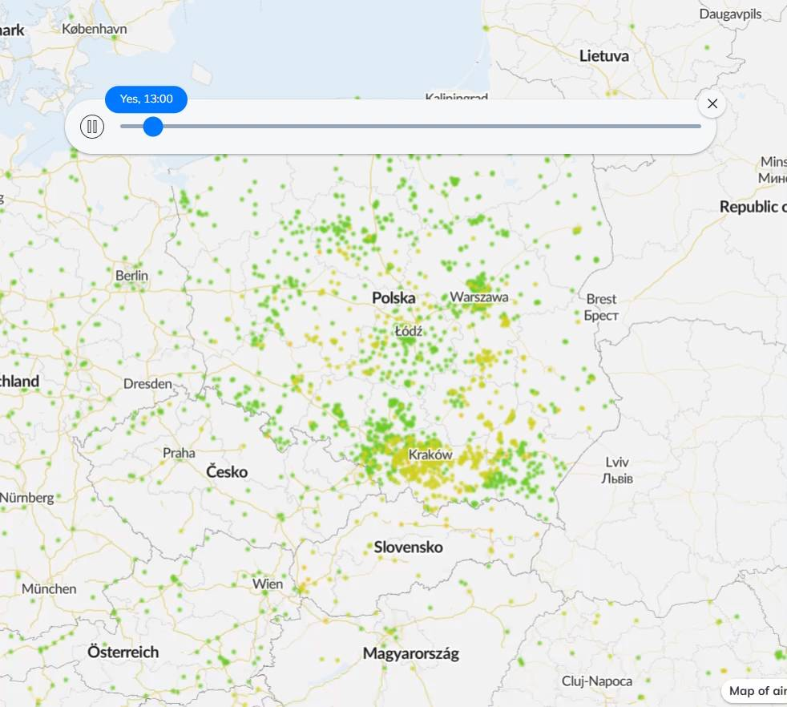
LIVE AIR QUALITY MONITORING IN POLAND (AIRLY):
24-HOUR CHANGES IN PM CONCENTRATION [1-2.07.2026]

Slide 5
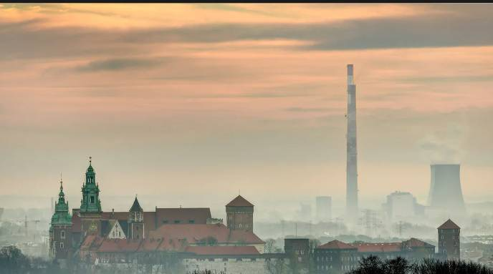
ENVIRONMENTAL PROBLEM
EXAMPLE
WINTER SMOG IN SOUTHERN POLAND CAUSES:
  high PM2.5 concentration,
  respiratory diseases,
  premature deaths,
  redyced quality of life
Smog in Kraków

Slide 6


EU GREEN DEAL: DEFINITION
It is a new growth strategy that aims to transform the EU into a fair and prosperous society with a modern, resource-efficient and competitive economy where there are no net emissions of greenhouse gases in 2050.
Core goals:
  Climate neutrality by 2050
  Protection of natural capital
  Decoupling economic growth from resource use
  Just and inclusive transition

Slide 7



GREEN DEAL IN POLAND
Energy transition in coal regions
Air quality improvement policies
Support programmes that help coal‑dependent regions shift toward renewable energy, create new green jobs, and ensure a socially just transformation.
Regulations and local measures designed to reduce particulate matter and NO₂ emissions, enhance urban air monitoring, and protect public health.
Water and soil protection initiatives
“Clean Air” programme
Actions aimed at safeguarding freshwater ecosystems and soil quality through monitoring, pollution prevention, and sustainable land‑use practices.
A national initiative focused on reducing air pollution by improving household heating systems, increasing energy efficiency, and promoting low‑emission technologies.

Slide 8

Improving education and skills is a key part of the overall vision for digital transformation in Europe.
Why digitalisation matters for the environment:
KEY INDICATOR | DESCRIPTION
Real‑time environmental monitoring | Continuous, sensor‑based tracking of air, water, and soil quality that enables rapid detection of pollution events and supports evidence‑based environmental decision‑making.
Satellite data (Copernicus) | High‑resolution Earth observation data used to monitor land use, emissions, climate trends, and environmental risks, supporting carbon accounting and long‑term sustainability planning.
Automated reporting systems | Digital platforms that collect, validate, and submit environmental data automatically, reducing human error, improving transparency, and accelerating compliance with EU environmental regulations.
AI‑based environmental analysis | Advanced machine‑learning models that identify pollution patterns, forecast environmental risks, and optimize resource use, enabling more accurate and proactive environmental management.
EU DIGITAL STRATEGY: DEFINITION

Slide 9

DIGITAL TOOLS IN POLAND
Airly - air quality sensors; real-time PM2.5 measurements available through mobile application.
[https://airly.org/map/pl/]
GIOŚ – official national monitoring network providing legally recognised measurements.
[https://www.gov.pl/web/gios]
Geoportal – environmental risk maps
[https://www.geoportal.gov.pl/]
Copernicus - satellite observations supporting pollution analysis.
[https://www.copernicus.eu/en]

Slide 10
EU STANDARDISATION STRATEGY: DEFINITION
Standards are embedded in policy objectives geared towards industrial competitiveness, free movement of goods and services in the internal market, innovation, safety, consumer, worker
Why standards matter:
  Safety and reliability
  Interoperability
  Quality of environmental data
  Support for innovation

Slide 11
ENVIRONMENTAL STANDARDS
Unified technical and regulatory requirements that specify how environmental impacts must be measured, reported, and minimized, ensuring consistent protection of air, water, soil, and public health.
Environmental Standards Applied in the Case:
ISO 14001 — Environmental management
Directive (EU) 2024/2881 on Ambient Air Quality
Systematic management of environmental impacts.
Defines legal limits for PM10, PM2.5 and NO₂.
ISO 50001 — Energy management
INSPIRE Directive
Structured improvement of energy efficiency.
Standardised environmental spatial data.

Slide 12
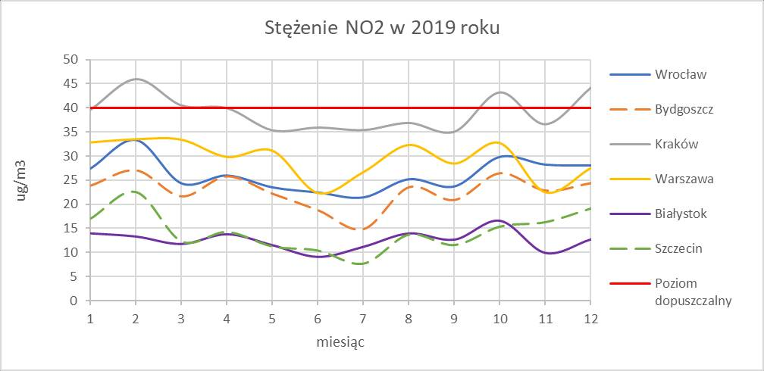
AIR QUALITY STANDARDS
Air quality standards are legal limits established by the European Union to protect human health and the environment. Member States are required to continuously monitor air pollution and take corrective actions when the limits are exceeded.
NO₂ Concentration in Poland in 2019. Author: Zuzanna Dąbrowska
Pollutant
EU limit
Environmental Impact
PM10 (Particulate
Matter ≤10 μm)
PM2.5 (Particulate
Matter ≤2.5 μm)
NO₂ (Nitrogen Dioxide)
Daily limit 50 µg/m³
Annual limit 10 µg/m³ (new EU target)
Annual limit 20 µg/m³
Fine dust particles that can cause respiratory diseases and reduce visibility.
Very fine particles that penetrate deep into the lungs and bloodstream, increasing the risk of cardiovascular and respiratory diseases.
Mainly emitted by road transport and industry; contributes to smog formation and irritates the respiratory system.

Slide 13
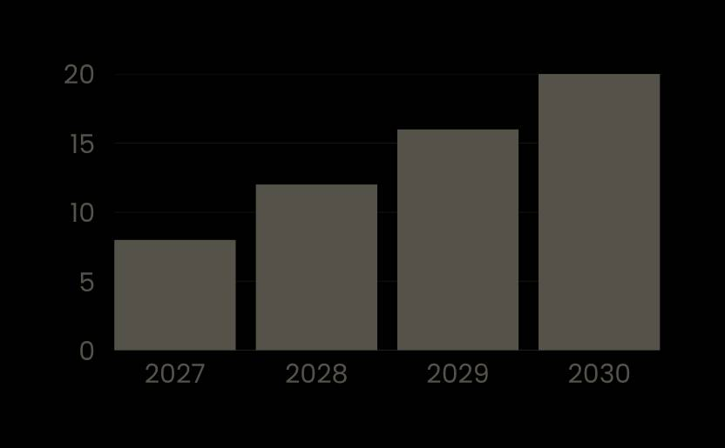
01.
UNIFIED DATA FORMATS
STANDARDS & DIGITALISATION
Environmental standards define consistent measurement and reporting rules, enabling digital systems to collect and compare environmental data reliably across regions and sectors. (np. INSPIRE, ISO data schemas)
02.
SENSOR CALIBRATION AND QUALITY ASSURANCE
Standards ensure that digital sensors (air quality, water quality, noise, emissions) operate with verified accuracy, making real‑time monitoring trustworthy and legally usable.
03.
INSPIRE — SPATIAL DATA INTEROPERABILITY
Digital platforms follow shared standards so that data from satellites, local sensors, laboratories, and public institutions can be integrated into one coherent system.
04.
CYBERSECURITY FOR ENVIRONMENTAL INFRASTRUCTURE
Standards define security requirements for digital systems controlling critical environmental infrastructure (e.g., water treatment, air monitoring networks), protecting them from cyber threats.

Slide 14
ETHICS, STANDARDS AND ENVIRONMENTAL PROTECTION
Should authorities publish all pollution data? YES, because:
Transparency in emissions reporting
Protecting public health
Clear, accurate and publicly accessible reporting of environmental data that prevents manipulation, builds trust and ensures accountability in environmental governance.
Implementing environmental policies and standards that reduce pollution exposure and safeguard the health and well‑being of citizens across the EU.
Preventing greenwashing
Responsibility toward future generations
Ensuring truthful, evidence‑based environmental claims so that companies cannot mislead consumers about the real ecological impact of their products or practices.
Acting ethically to preserve natural resources, biodiversity and climate stability so that future generations inherit a safe, healthy and sustainable environment.

Slide 15
CASE ANALYSIS
The case demonstrates that environmental protection depends on cooperation between:
  digital technologies,
  international standards,
  ethical responsibility,
  public institutions.
Without ethics environmental data could be manipulated.
Without standards the measurements would not be reliable.
Without digitalisation citizens would not receive real-time information.

Slide 16
CITIZEN ENGAGEMENT
Where to report environmental issues:
  GIOŚ — environmental interventions
[https://www.gios.gov.pl/pl/]
  Municipal Guard — illegal waste burning
[phone number: 112 or 986]
  Wody Polskie — river pollution [https://www.gov.pl/web/wody-polskie]
  General Directorate for Environmental Protection — environmental damage
[https://www.gov.pl/web/gdos]

Slide 17
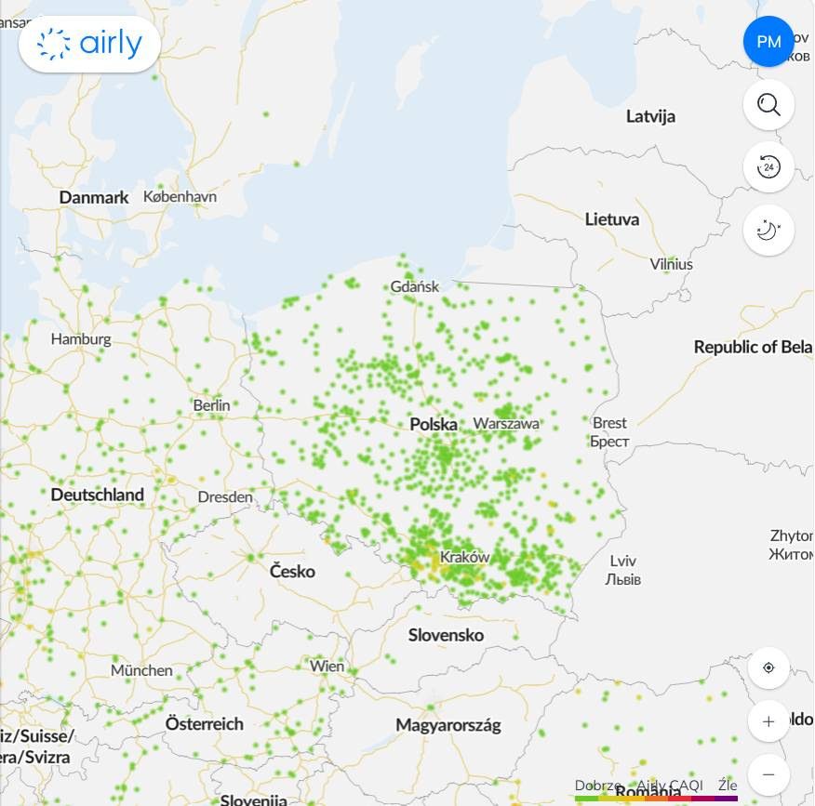

GOOD ENVIRONMENTAL PRACTICES
Check air quality
Use apps like a Airly before outdoor activities.
Report illegal waste
Use GIOŚ reporting platform.
[https://www.gov.pl/web/gios/zglos-nielegalne-postepowanie-z-odpadami?utm_source=chatgpt.com]
Participate in consulattions
Take part in local environmental planning.
Buy EU Ecolabel products
Look for the EU Ecolabel logo.
Airly app - current [02.07.2026, 11:15] air quality in Poland

Slide 18
THANK YOU
Individual contribution
Zuzanna Dąbrowska
  Case study research
  Environmental standards
  Digital monitoring systems
Oliwia Rekosz
  Ethics, Standards and Environmental Protection
  Citizen engagement
  Good practices
  Final editing

