Slide 1

Digital air quality monitoring as an environmental protection tool in the EU
Authors:
Natalia Tryk
Małgorzata Socha
Magda Wojs
Jan Przybyłowski

Slide 2
Introduction
The Critical Problem: Air pollution remains one of the largest environmental hazards, severely impacting human health and damaging fragile ecosystems.
The Data Gap: Successfully combatting smog and urban pollution requires highly accurate, dynamic, and hyper-local data.
Project Objective: To showcase how cutting-edge digital tools and IoT sensor networks revolutionize air monitoring to drive real-world ecological solutions.

Slide 3
What is smog?
Definition: Smog is a highly toxic, dense mixture of air pollutants—primarily particulate matter (PM2.5 and PM10) and ground-level ozone—that accumulates in the lower layers of the atmosphere under specific weather conditions.
Primary Sources of Emissions:
Residential Heating: Combustion of solid fuels (coal, wood, waste) in outdated domestic boilers—often the leading cause of winter smog.
Urban Transport: Exhaust fumes, nitrogen oxides (NOx), and dust from vehicle braking and tire wear.
Industrial Activity: High-emission manufacturing plants, coal-fired power plants, and heavy chemical processing.

Slide 4
Which Pollutants Do We Measure?
Pollutant | Source | Health Effects
PM10 | Stoves & furnaces, transport | Respiratory issues
PM2.5 | Fuel combustion | Heart disease
NO₂ | Vehicles / Automotive emissions | Lung irritation
O₃ | Chemical reactions | General health issues

Slide 5

Impact of Air Pollution on Human Health
Air pollutants can enter the respiratory and circulatory systems, causing serious health problems and reducing quality of life.
Main health effects:
Irritation of the eyes, nose, and throat
Coughing and breathing difficulties
Worsening of asthma and allergies
Increased risk of lung diseases
Higher risk of cardiovascular diseases
https://www.news-medical.net/news/20241205/Does-air-pollution-worsen-Long-COVID-Researchers-weigh-in.aspx

Slide 6
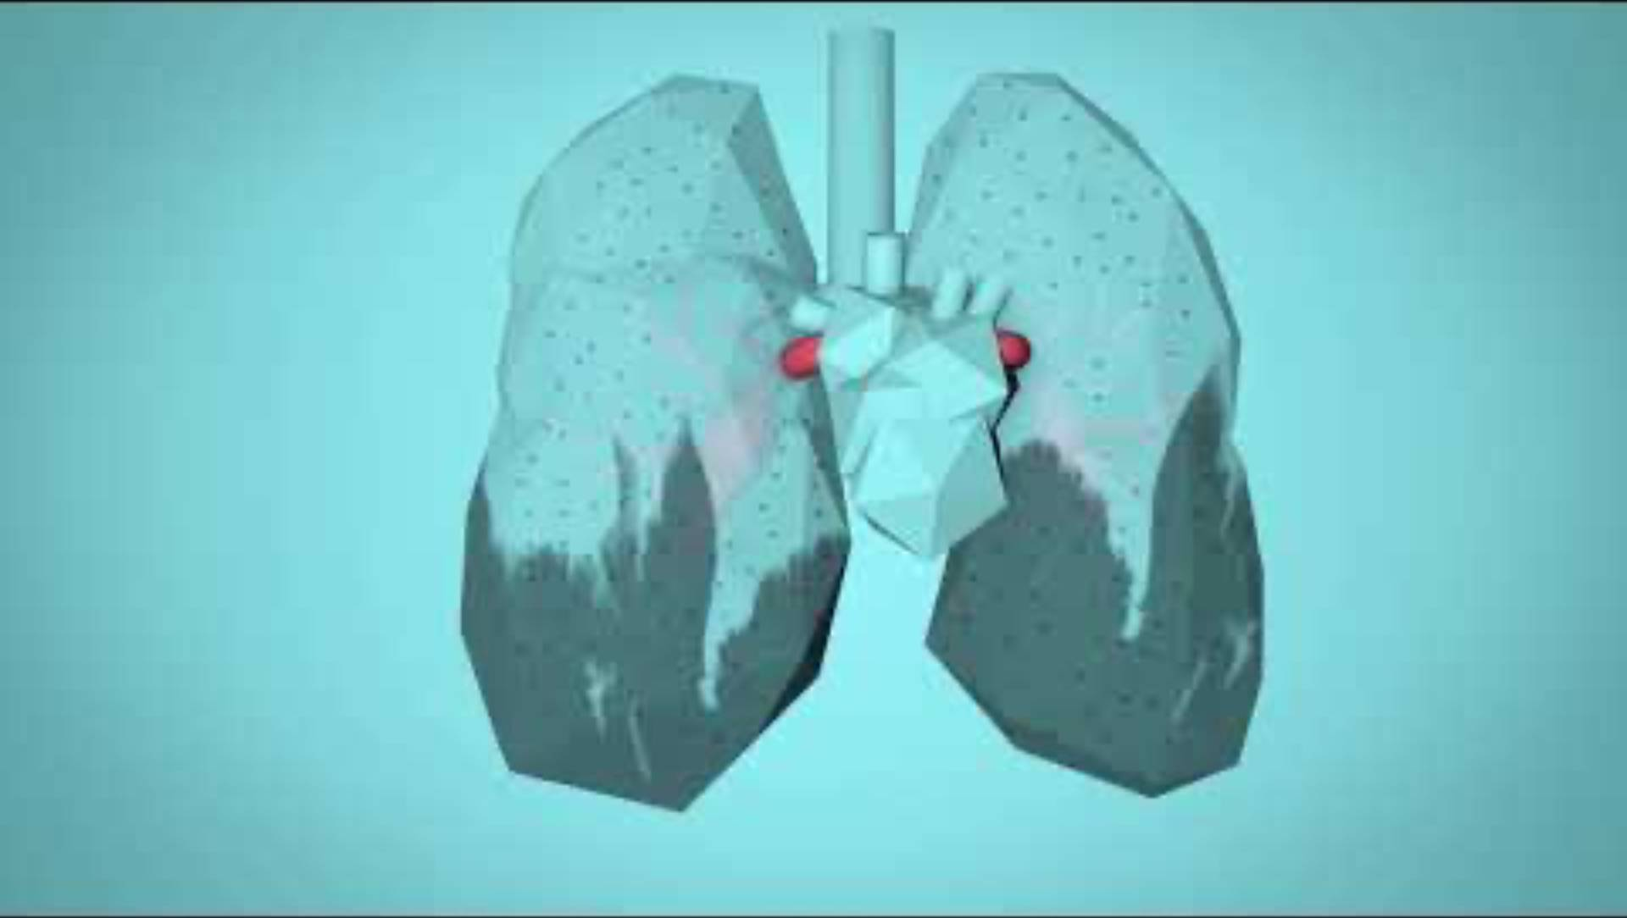

Slide 7
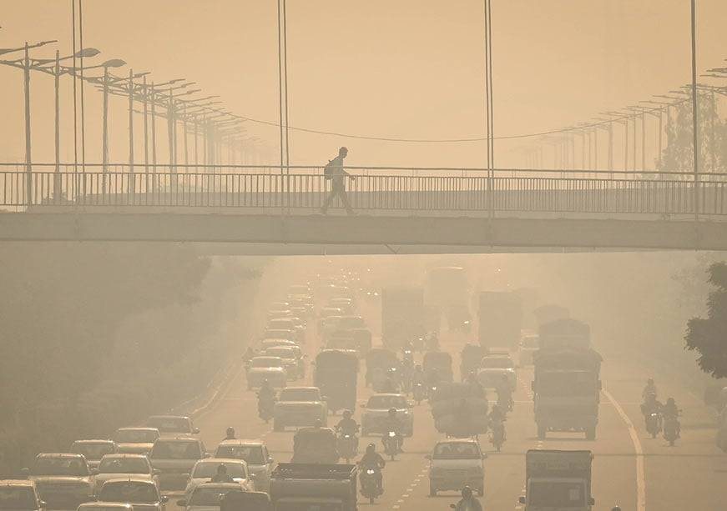
Impact of Air Pollution on the Environment
Air pollution affects not only human health but also ecosystems, biodiversity, and natural resources.
Main environmental consequences:
Damage to plants and reduced crop growth
Deterioration of soil and water quality
Formation of acid rain
Loss of biodiversity
Contribution to climate change
https://www.orfonline.org/expert-speak/air-pollution-when-no-conclusive-data-becomes-the-headline

Slide 8
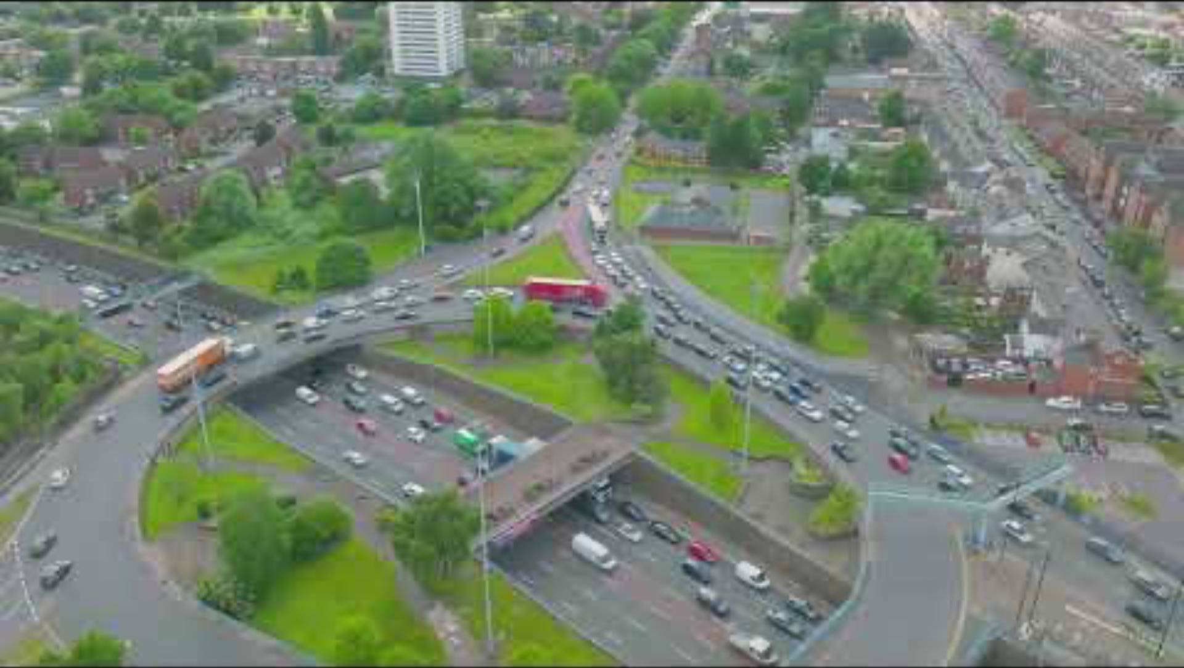

Slide 9

How Does Air Quality Monitoring Work?
Data Flow Pipeline:
Sensor Node ➔ Connectivity ➔ Cloud Server ➔ Application ➔ End User
The Process Explained:
Sensor Node (Detection): Compact, IoT-enabled sensors measure PM2.5, PM10, and gas concentrations in real-time.
Connectivity (Transmission): Encrypted data is transmitted wirelessly via 5G, Wi-Fi, or LoRaWAN networks to the cloud.
Cloud Server (Processing): Central servers ingest the raw data, perform quality control, and calculate the Air Quality Index (AQI).
Application (Visualization): Interactive dashboards and mobile apps map the data to make spatial-temporal pollution patterns visible.
End User (Action): Citizens receive health alerts, and policymakers implement targeted emission control measures.

Slide 10
Digital Enabling Technologies
Internet of Things (IoT) - distributed sensor networks delivering continuous, hyper-local air quality measurements,
Cloud Computing – scalable infrastructure for secure data storage, API integrations, and instant processing,
Big Data - analytical engines processing massive datasets to identify pollution clusters and trends,
Artificial Intelligence (AI) - machine learning models forecasting smog episodes and optimizing traffic dispersion,
Mobile Applications - user-friendly portals democratizing public access to real-time local air pollution indices.

Slide 11
Air Quality Monitoring Systems
How do monitoring systems work?
Air quality monitoring systems collect data from sensors installed in cities, industrial areas, and residential zones. The collected information is transmitted in real time to online platforms and mobile applications.
Key functions:
Measuring pollutant concentrations (PM2.5, PM10, NO₂, O₃)
Collecting and storing environmental data
Providing real-time air quality information
Supporting decision-making by authorities

Slide 12
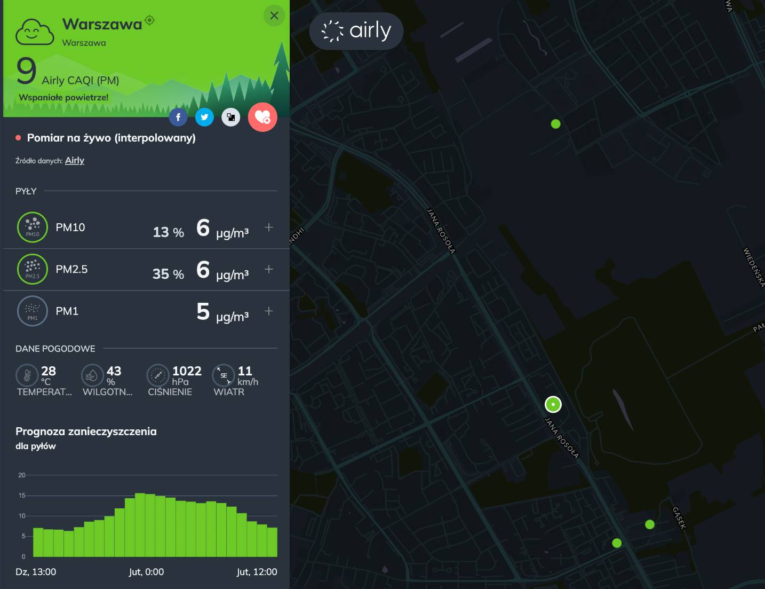
Airly Monitoring Network
What is Airly?
Airly is a Polish company that operates a network of air quality sensors across Europe.
Main features:
Real-time air quality measurements
Interactive pollution maps
Mobile and web applications
Air quality forecasts and alerts
Benefits:
Easy access to environmental data
Increased public awareness
Support for local governments and researchers
https://airly.org/map/pl/

Slide 13
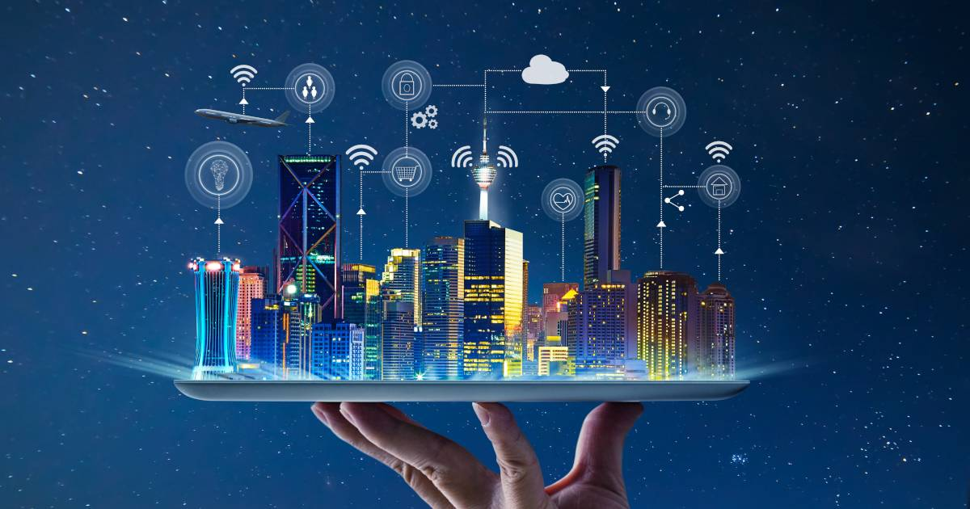
Smart Cities and Air Quality Monitoring
Monitoring in Smart Cities
Modern cities use digital technologies to improve environmental management and public health.
Examples of smart solutions:
IoT-based sensor networks
AI-powered pollution forecasting
Automated alerts for residents
Integration with urban planning systems
Why is it important?
Smart monitoring systems help cities respond faster to pollution events and develop more effective environmental policies.
https://www.teraz-srodowisko.pl/aktualnosci/smart-city-popyt-na-technologie-wartosc-rynku-13000.html

Slide 14
Definition of ISO
ISO (International Organization for Standardization) is an international organization that develops standards to ensure quality, safety, and consistency across various industries and technologies.
Why is ISO Important?
Standardizes processes and operating methods
Increases data reliability and accuracy
Facilitates international cooperation
Supports innovation and technological development
Importance for Air Quality Monitoring
ISO standards help ensure that air quality measurements are accurate, reliable, comparable, and compliant with international standards.

Slide 15

ISO Standard Example
ISO 14001 – Environmental Management System
An international standard that defines the principles for managing an organization's environmental impact.
Application in Combating Smog
Monitoring pollutant emissions
Reducing the environmental impact of activities and operations
Planning environmentally friendly initiatives
Supporting sustainable development policies
Benefits
Improved environmental protection
Compliance with European Union requirements
Increased environmental awareness

Slide 16
Examples of ISO Standards Related to Air Quality Monitoring
ISO 16000 – Indoor Air Quality
Methods for measuring pollutants inside buildings
Air quality control in schools, offices, and hospitals
ISO 14031 – Environmental Performance Evaluation
Assessment of the effectiveness of anti-smog measures
Evaluation of air quality changes based on collected data
ISO 37120 – Sustainable Cities
Indicators for measuring residents' quality of life
Use of environmental data for city management
Support for Smart City initiatives
Common Goal of These Standards

Slide 17


Slide 18
Environmental Standardisation
Why is it Needed?
Data Comparability: Enables precise cross-border benchmarking and identical evaluation across all EU member states,
Measurement Credibility: Guarantees high-precision, tamper-proof, and universally trusted data structures,
Joint EU Actions: Coordinates swift regional responses to transboundary smog episodes and unified policy execution.

Slide 19
Environmental Standardisation
What is Standardised?
Measurement Methodologies: Unifying reference parameters and calibration criteria for modern sensor nodes,
Sensor Location Rules: Regulating precise micro-siting of nodes relative to traffic density, housing, and industries,
Result Dissemination: Structuring common data reporting schemas and API standards for real-time open access.

Slide 20
Monitoring & The European Green Deal
Strategic Alignment: Advanced air monitoring directly supports the Zero Pollution Action Plan, a key pillar of the European Green Deal aiming to reduce air, water, and soil pollution to non-harmful levels by 2050.
Targeted Pollution Reduction: Real-time environmental data provides the foundation needed to enforce strict EU limit values for key pollutants (like PM2.5 and NO2) and implement immediate corrective actions.
Improving Quality of Life: By turning raw data into public health policies, the EU aims to significantly decrease premature deaths and chronic illnesses caused by poor air quality, creating healthier urban spaces.

Slide 21
Air Quality Monitoring and the European Digital Strategy
What is the European Digital Strategy?
The European Digital Strategy aims to promote the use of digital technologies to improve people's lives, strengthen the economy, and support sustainable development.
How does air quality monitoring support this strategy?
Collection of environmental data in real time
Use of digital platforms and mobile applications
Better access to information for citizens
Data-driven decision-making by public authorities
Key technologies involved:
Internet of Things (IoT)
Cloud Computing
Big Data Analytics
Artificial Intelligence (AI)

Slide 22
Benefits of Digital Technologies in Environmental Protection
Advantages of digital monitoring systems
Faster detection of pollution incidents
More accurate environmental data
Improved public awareness
Better planning of environmental policies
Support for sustainable urban development
Contribution to EU Goals
Digital technologies help the European Union:
Reduce environmental risks
Improve public health
Build smarter and greener cities
Achieve sustainability objectives

Slide 23
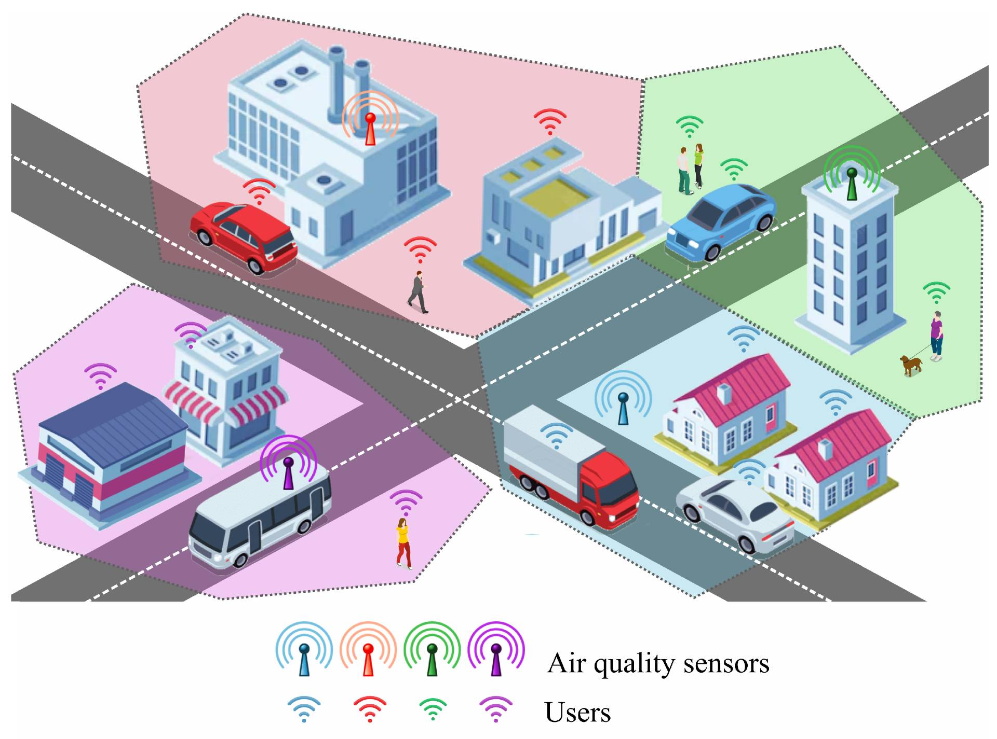
Smart Air City Solution
Sensor Network
Deployment of a highly densified grid of low-cost, compact IoT electrochemical and laser-scattering sensor nodes throughout urban zones.
Provides hyper-local, continuous, real-time measurements of key indicators (PM2.5, PM10, NOx, CO).
2. AI Predictive Engine (Process)
Advanced machine learning models analyzing spatial weather forecasts, traffic density projections, and historical emissions.
Delivers precise smog forecasts up to 48 hours in advance, giving local authorities and citizens time to prepare.
3. Mobile Application (Communicate)
Intuitive mobile portal offering hyper-local spatial mapping of air quality indexed to the user’s live geolocation.
Empowers citizens with real-time awareness and personalized healthcare advisories for outdoor activities.
4. Automated Smog Alerts (Act)
Dynamic push notification protocols triggered automatically whenever pre-set pollution thresholds are crossed.
Activates proactive safety warnings for vulnerable populations and syncs with municipal traffic mitigation systems.
https://www.mdpi.com/1424-8220/25/3/875

Slide 24
Benefits for residents
For Residents
Access to real-time air quality information
Ability to reduce exposure to smog
Better health protection for children and the elderly
Alerts when pollution levels exceed safety standards

Slide 25
Benefits for the city
More effective planning of anti-smog measures
Faster identification of highly polluted areas
More efficient use of public funds
Support for developing local environmental strategies

Slide 26
Benefits for the city Environment and Economy
Reduction of pollutant emissions
Improved quality of life for residents
Increased environmental awareness
Lower healthcare costs related to air pollution
Support for achieving the goals of the European Green Deal

Slide 27
Conclusions
•Air pollution remains one of the most serious environmental and public health challenges in Europe.
•Digital technologies such as IoT, Artificial Intelligence, Big Data, and Cloud Computing have significantly improved air quality monitoring.
•Real-time environmental data enables faster responses to pollution events and supports evidence-based decision-making.
•Smart monitoring systems help protect citizens, improve environmental management, and support sustainable urban development.
•Air quality monitoring plays an important role in achieving the objectives of the European Green Deal and the European Digital Strategy.
•Investing in digital environmental technologies contributes to healthier communities and a cleaner future.

Slide 28
Division of work
Natalia Tryk Prepared the introduction to the project, including the problem of air pollution, the definition of smog, major air pollutants, and the impact of air pollution on human health. Researched the importance of accurate and standardized environmental measurements as a foundation for effective air quality monitoring.
Magda Wojs Prepared the section on the environmental impact of air pollution, air quality monitoring processes, digital enabling technologies, monitoring systems, Airly, and Smart City applications. Analyzed the role of technical standards in environmental monitoring systems, sensor reliability, and data collection.
Jan Przybyłowski Prepared the materials related to ISO standards, environmental management systems, air quality standards, and environmental standardization. Researched how standardization improves data comparability, measurement accuracy, and cooperation between institutions and countries.
Małgorzata Socha Prepared the sections on the European Green Deal, the European Digital Strategy, benefits of digital technologies, the Smart Air City solution, benefits for residents and cities, and the project conclusions. Analyzed how international standards and European policies support sustainable development, environmental protection, and digital transformation.
All team members contributed equally to source research, content review, discussion of project findings, and preparation of the final presentation.

