Slide 1


BIOBASEDCERT Monitoring Tool: Overview, Application and Web-based Implementaiton
Robust and Effective Sustainability Certification for Bio-based Systems
EDU4STANDARDS Webinar
Luana Ladu, Technische Universität Berlin
29 June 2026 - Online

Slide 2
Outline
Introduction to the BIOBASEDCERT Monitoring Tool - BMT (Dr. Luana Ladu, TU Berlin)
System level of the BMT (Mr. Nikola Matovic, TU Berlin)
Content level of the BMT (Dr. Iris Vural Gursel, Wageningen Research)
Outcome level of the BMT (Ms. Maulidia Khairani, University of Utrecht)
Q&A Session

Slide 3

Cluster of 3 Horizon Europe projects (2022-2025) :
Objective: To assess the effectiveness and robustness of sustainability certification schemes and labels, applicable to bio-based systems
HORIZON-CL6-2021-ZEROPOLLUTION-01-07: International and EU sustainability certification schemes for bio-based systems

Slide 4
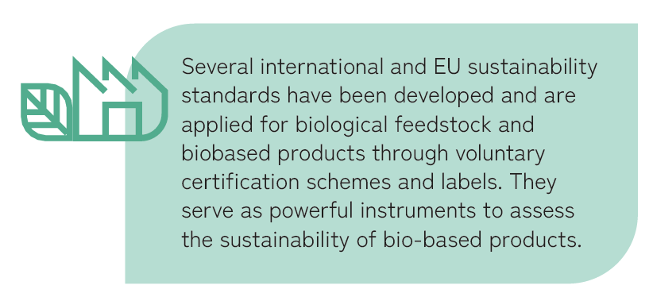

Background
Due to the rapid proliferation of sustainability certification schemes and labels (CSLs) and their varying effectiveness levels, the reliability of these systems has been questioned.
This is where the BIOBASEDCERT Cluster comes into play!
4

Slide 5

BIOBASEDCERT Monitoring Tool (BMT)
→ Assesses the robustness, comprehensiveness and effectiveness of existing CSLs applicable to bio-based products.
EU policymakers
Increase transparency on the performance of CSLs.
Provide understanding of how existing CSLs contribute to EU sustainability priorities.
Leverage the BMT to support regulatory implementation.
Sustainability certification schemes and labels (CSLs) owners
Identify and address gaps to drive improvements.
Promote harmonization of sustainability criteria and governance.
Audience
5

Slide 6









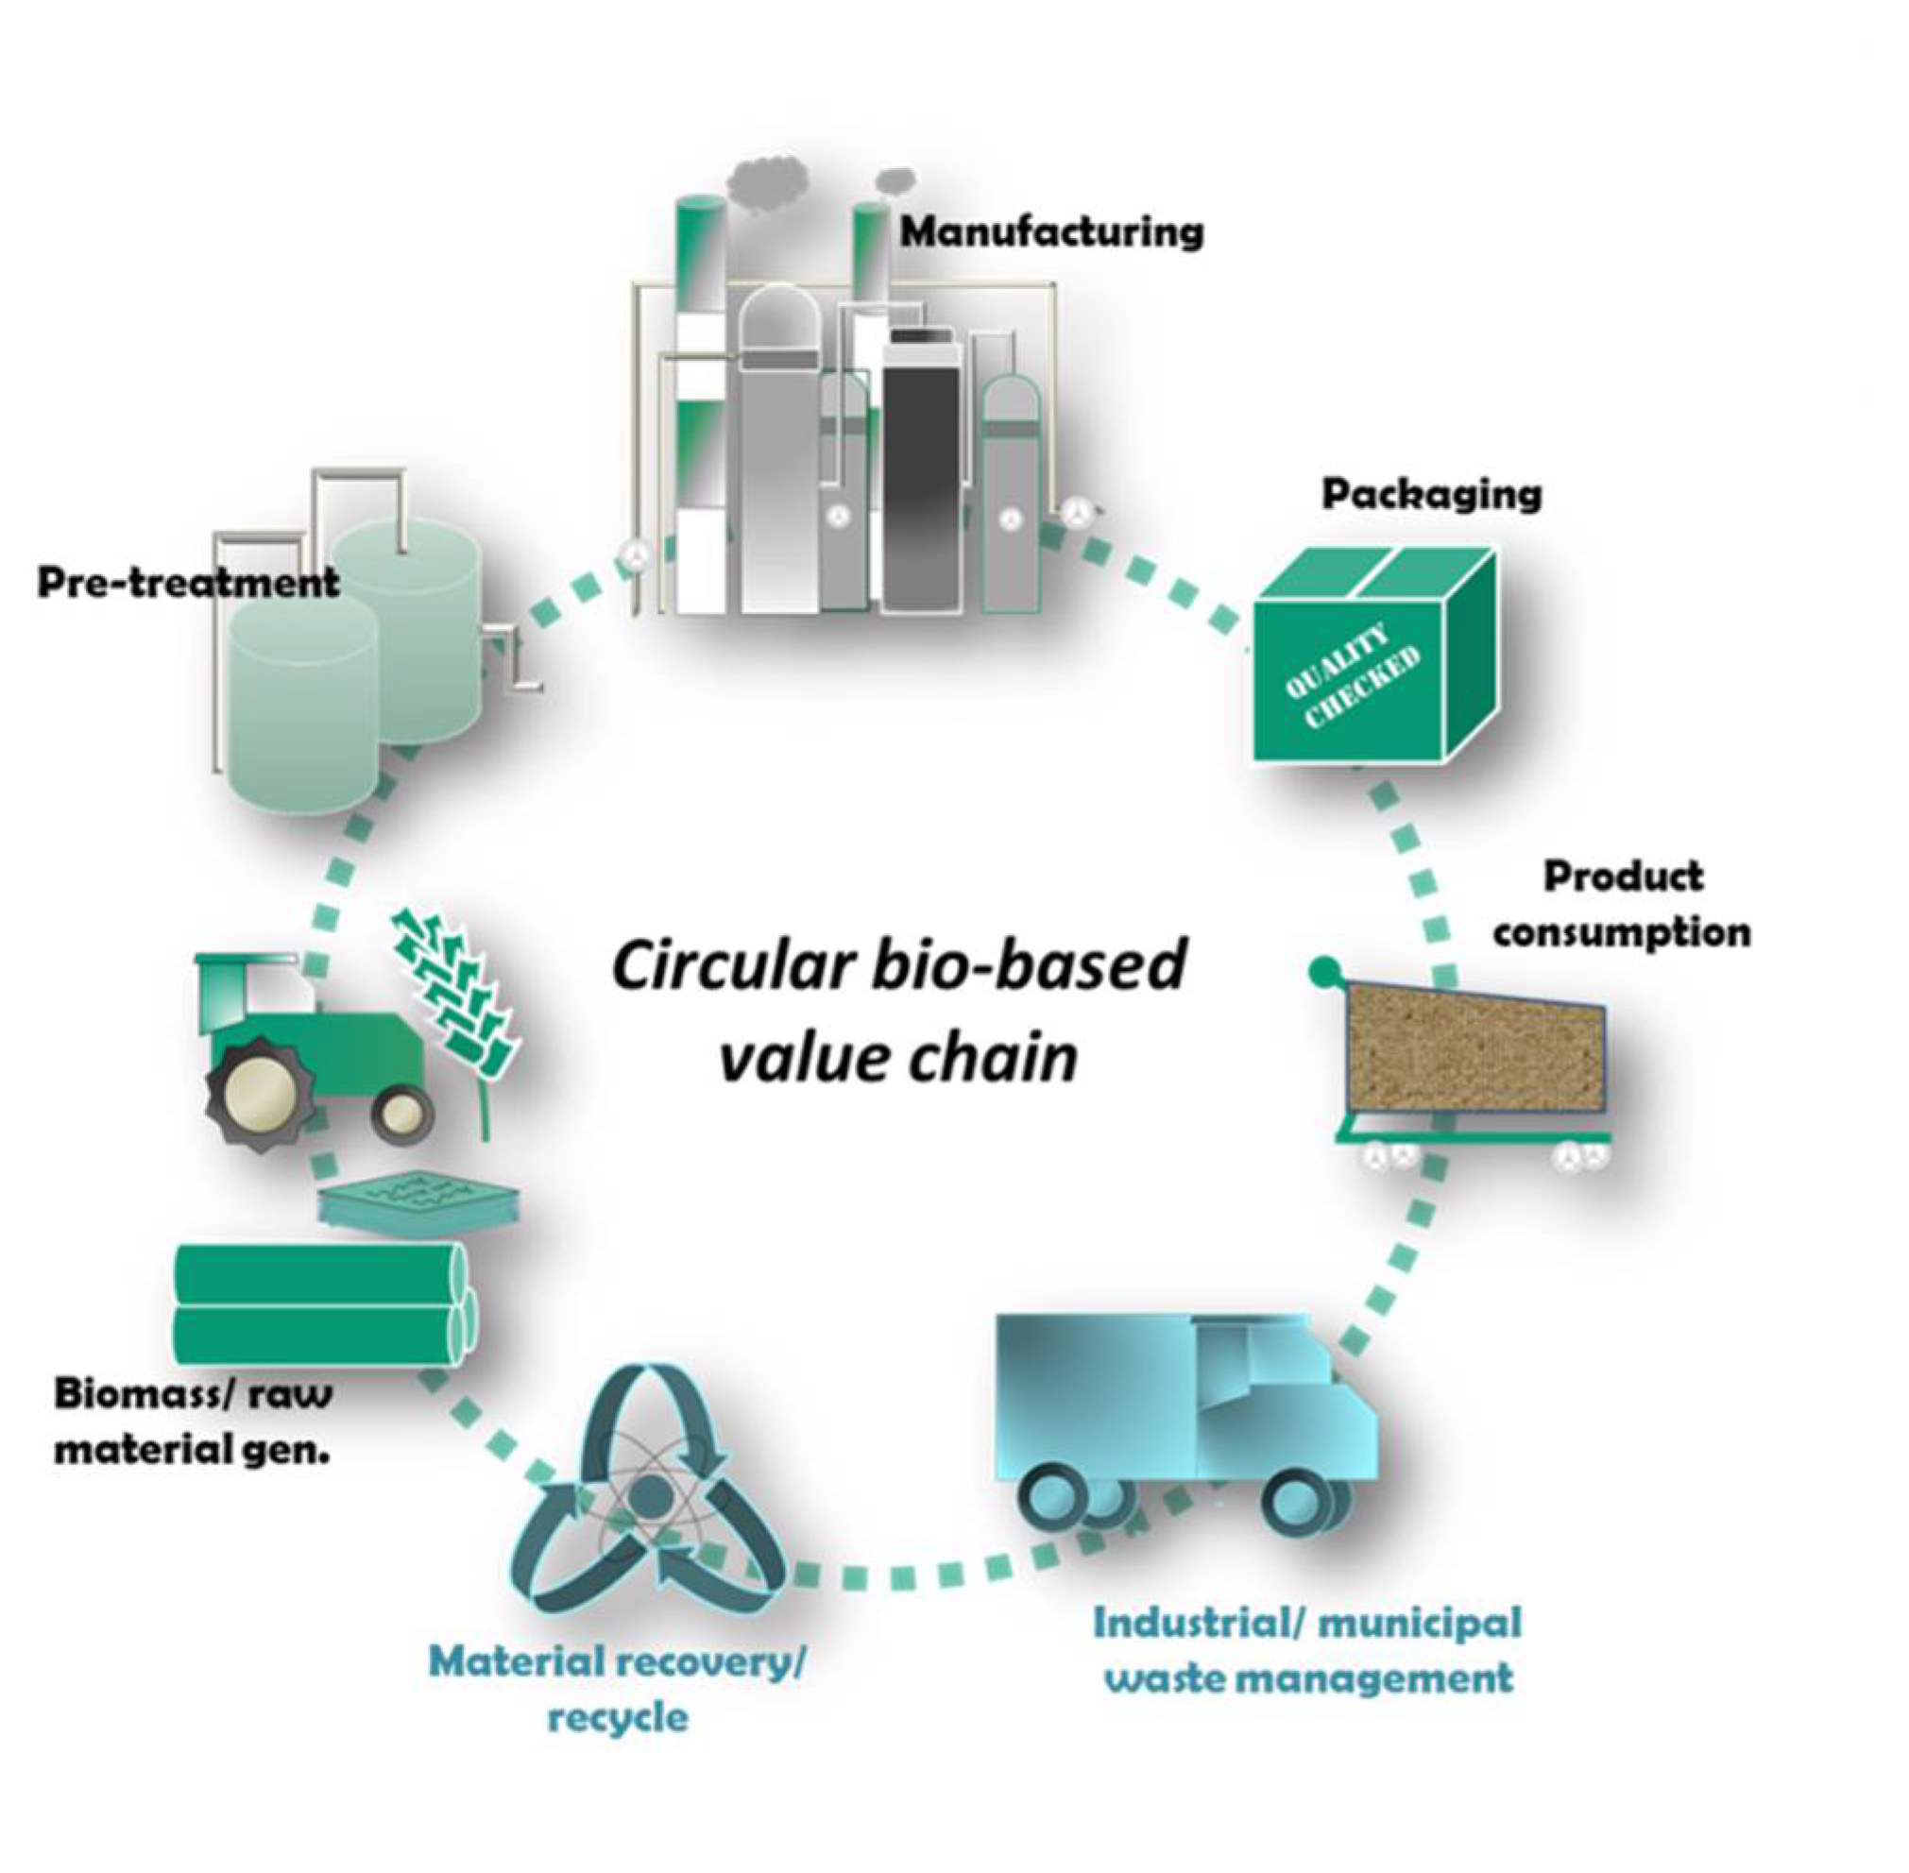



Scope of the BMT
Target: CSLs intended for industrial biobased value-chains and to biobased materials and products
Depth: Considering the entire value chain, capturing all aspects of a product’s life cycle
Geographical scope: considering CSLs applicable to bio-based products produced & traded within the EU.

Slide 7
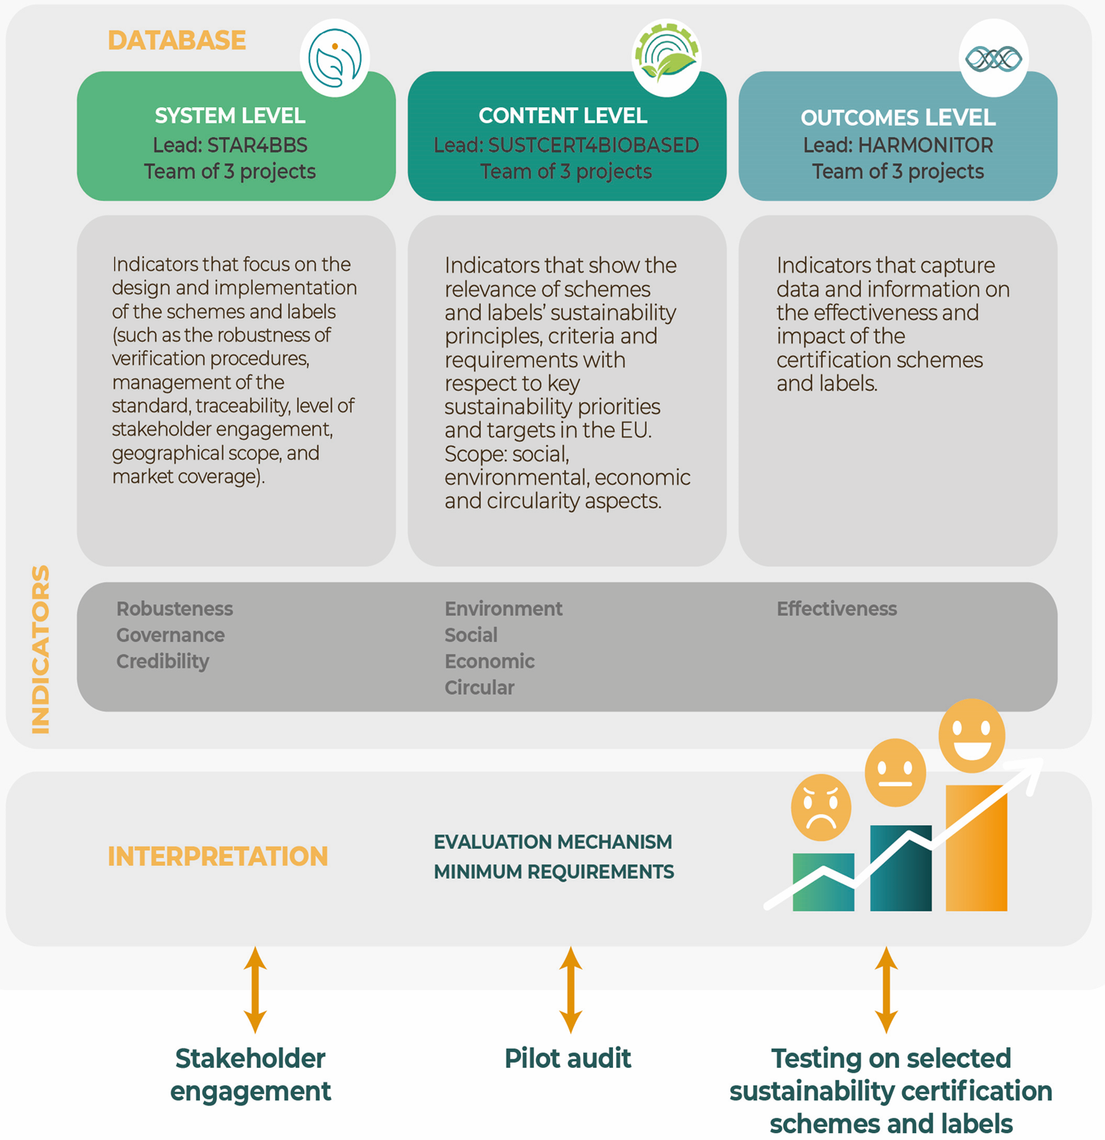
BMT Structure

Slide 8
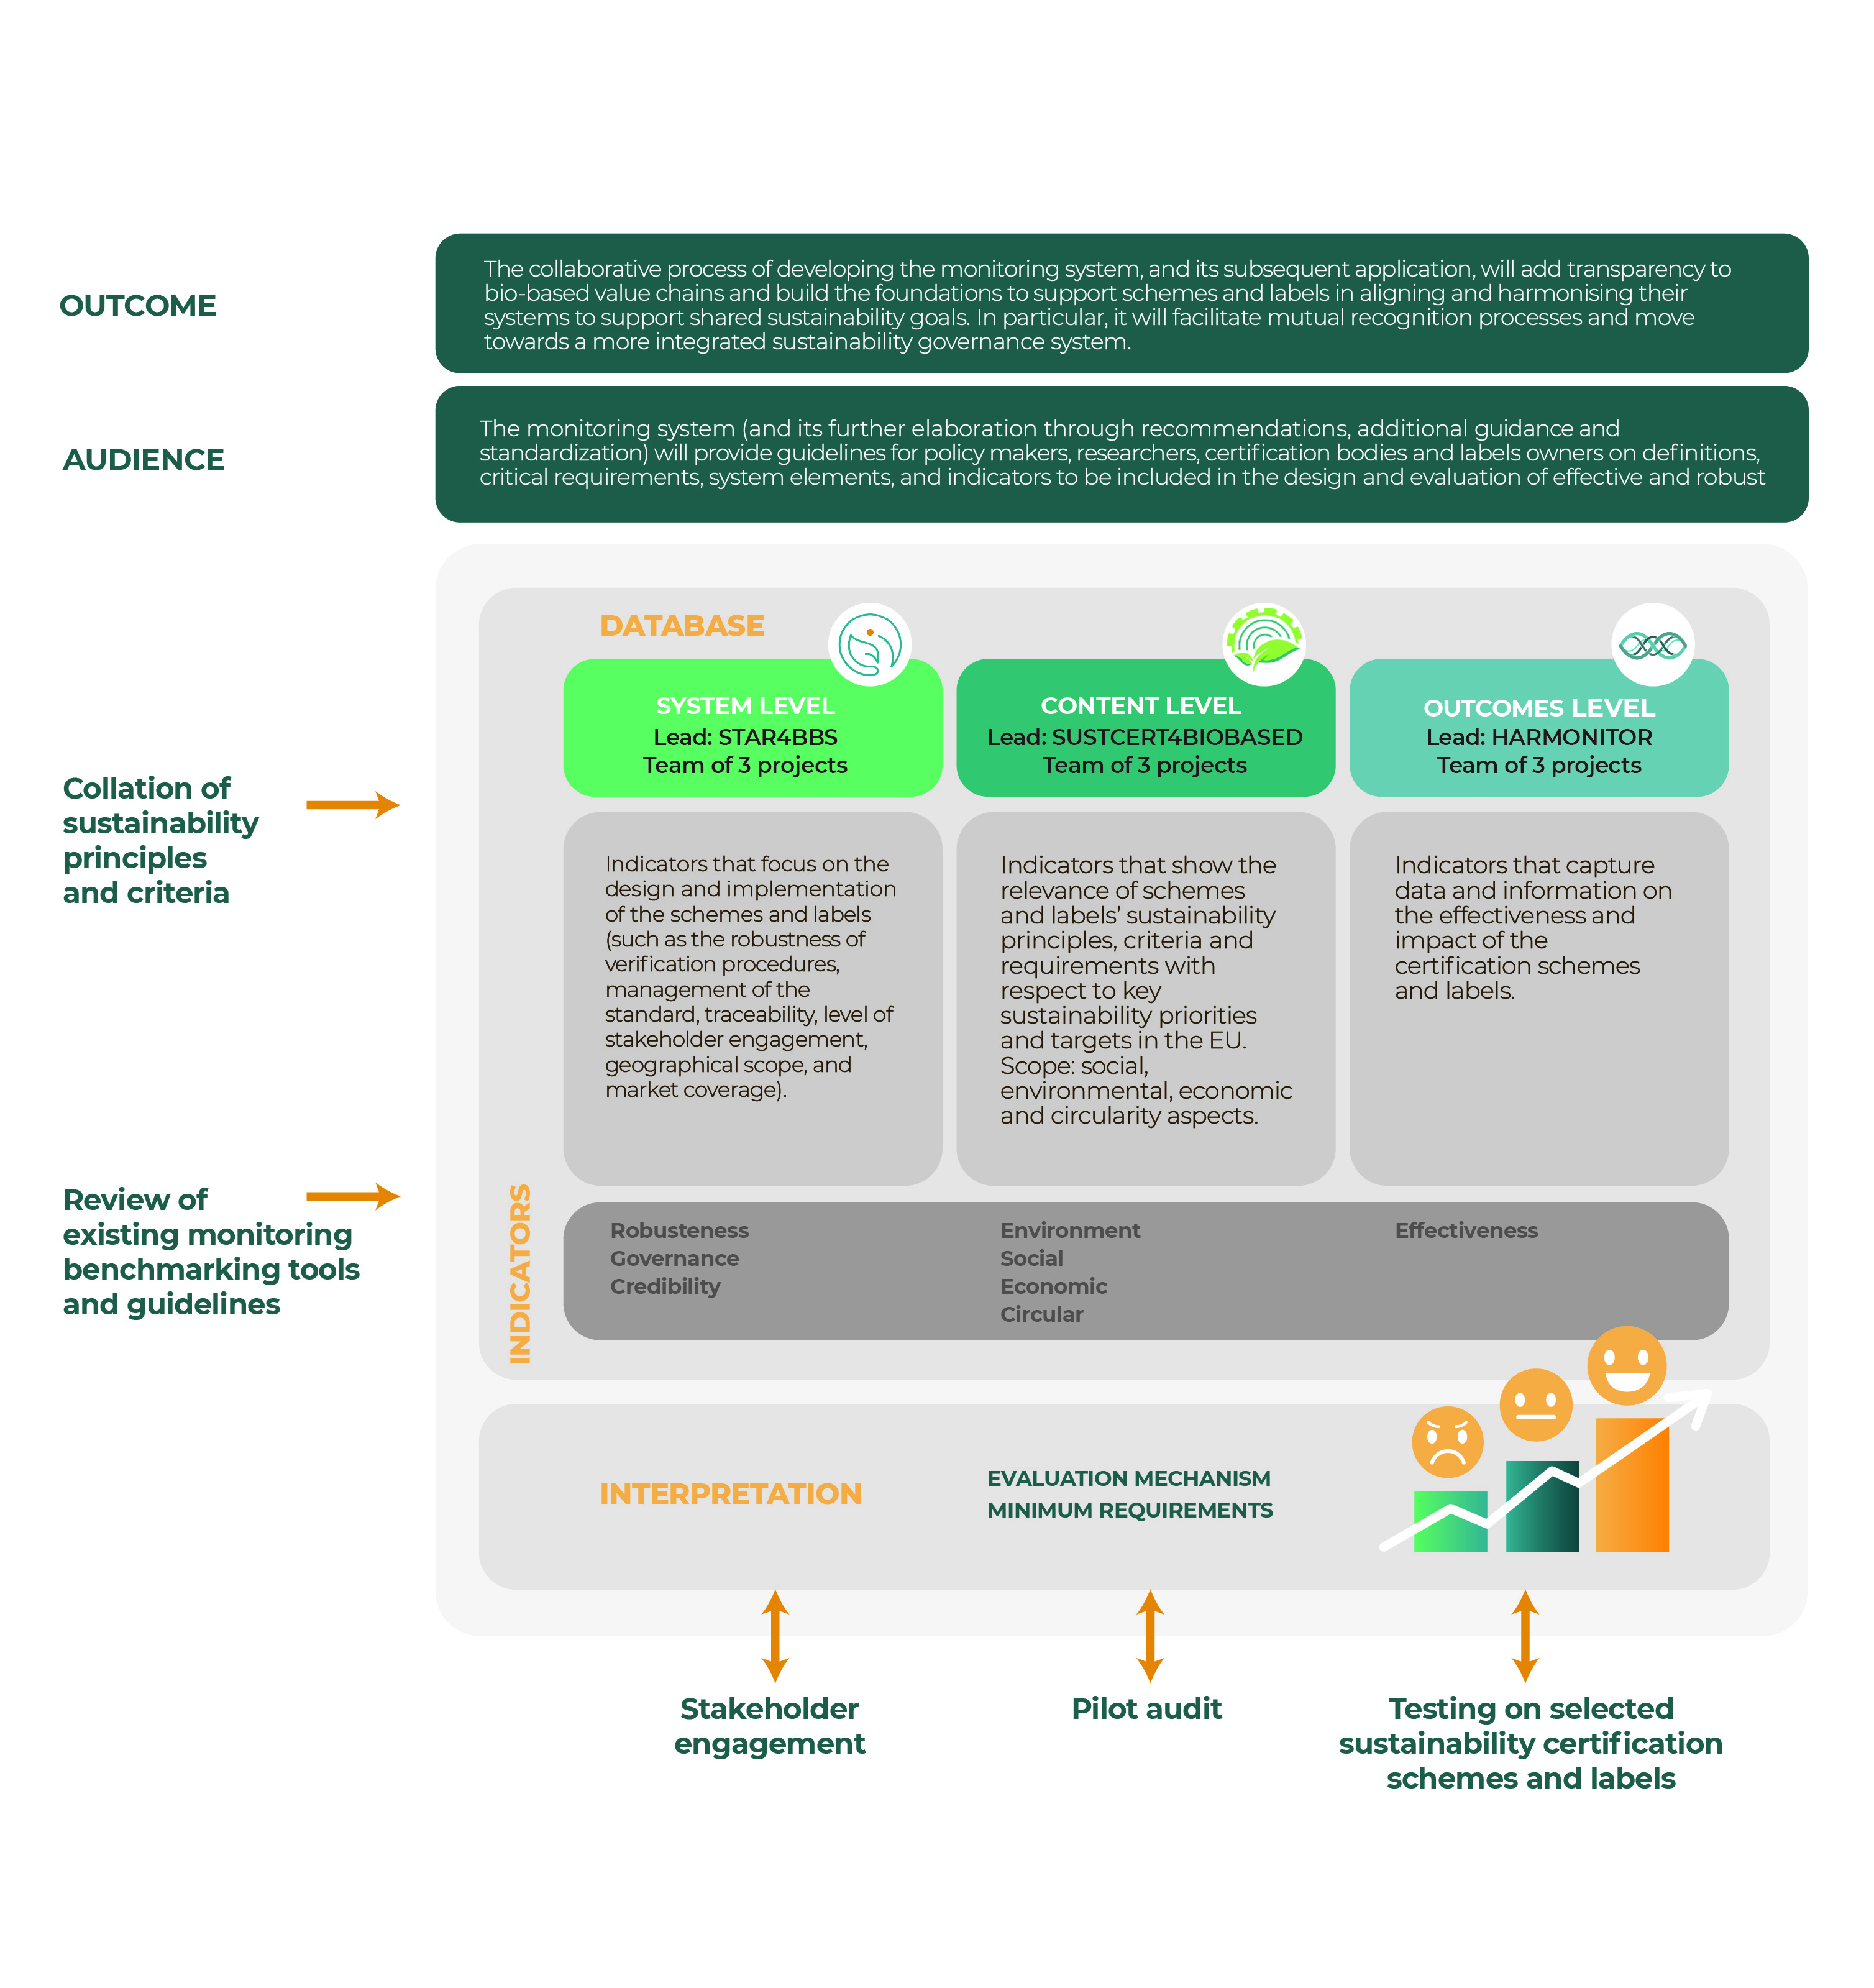
The BMT offers a comprehensive assessment
Categories (4)
Principles (17)
Criteria (58)
Requirements (58)
Categories (4)
Principles (19)
Criteria (93)
Requirements (232)
Categories (2)
Principles (4)
Criteria (8)
Requirements (26)
8

Slide 9
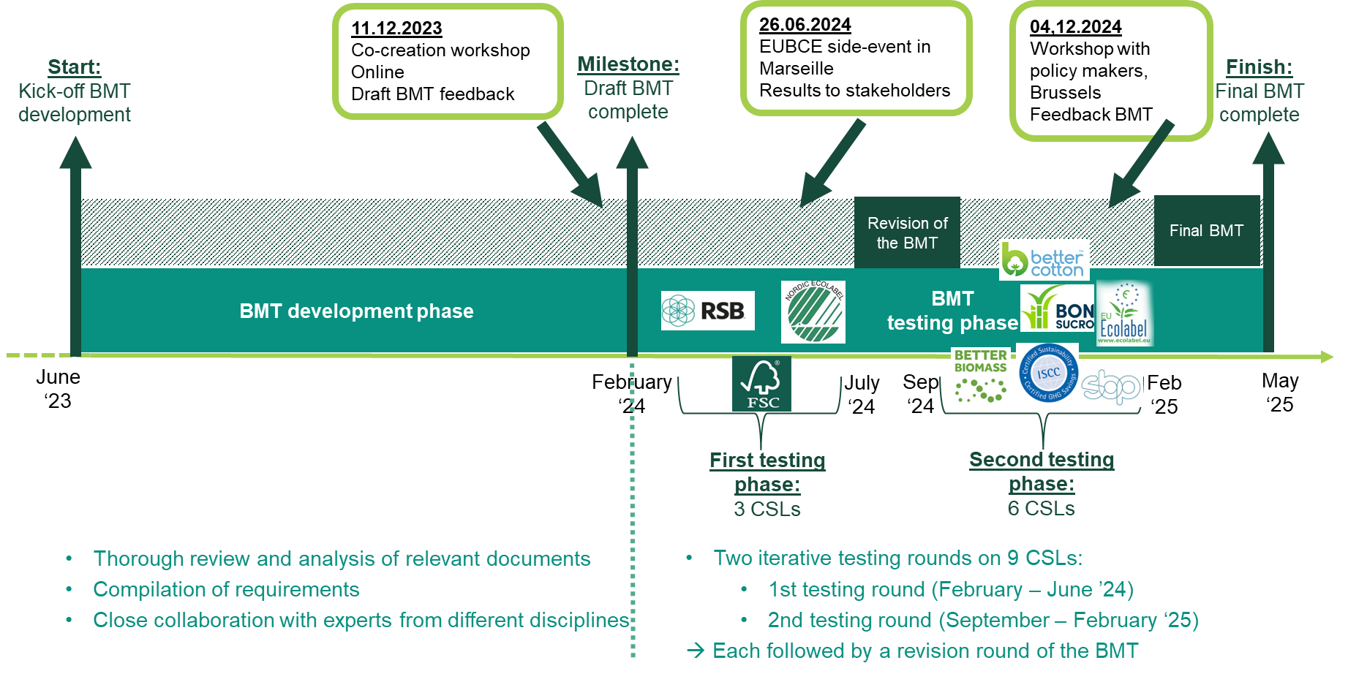
Development and Testing of the BMT

Slide 10

Components of the assessment
Pre-Screening Assessment – Identify evidence, scope and coverage
Assess compliance of CSLs documents with BMT criteria (documents review)
Conduct Interviews – Gather insights through outcome-level interviews.
Engage with CSLs – Hold kick-off meetings, Q&A sessions, and closing discussions.
Provide BMT Feedback – Offer input for continuous improvement.
10

Slide 11
Room for improvement of the BMT
An Excel-based tool with three separate sections, each representing a different level.
Manual data entry & calculations → Time-consuming and prone to errors.
Limited user accessibility → Excel-based tools might be difficult for some users.
Need for independent experts to conduct the assessment.
11

Slide 12
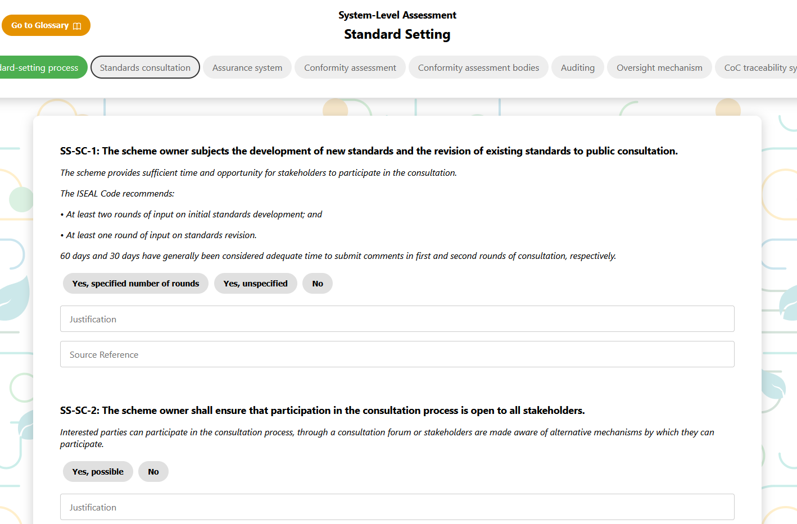
Solution: Web-based tool
User-friendly, online template of Excel-based BMT. ​
Enhances accessibility, data visualisation and dynamic reporting.​
Improved automatic scoring and processing.
Option to download the assessment.
Link: https://star4bbs.eu/web-tool/
Guide on how to use the tool.
https://www.youtube.com/watch?v=0oFy22sw6oM

Slide 13


THANK YOU FOR YOUR ATTENTION!
Contacts:
Luana.ladu@tu-berlin.de Matovic@tu-berlin.de (STAR4BBS)
iris.vuralgursel@wur.nl heleen.ballemans@wur.nl (SUSTCERT4BIOBASED)
H.M.Junginger@uu.nl M.khairani@uu.nl (HARMONITOR)
This presentation has been produced by ICONS in the context of the Horizon Results Booster services delivered to SUSTCERT4BIOBASED (GA 101059785 ), HARMONITOR (GA 101060133), and STAR4BBS (GA 101060588). This product doesn’t reflect the views of the European Commission.

Slide 14
BMT System level
EDU4STADARDS Webinar
Nikola Matovic, Technische Universität Berlin
29 June 2026 – Online

Slide 15









System level – methodology and the concept
Comparison of the requirements for the selected tools
01
Development of a list of elements
02
Identification and selection of elements
Consistencies with policies and guidelines and selection of MR
03
04
05
Inputs from stakeholders
06
Validation of the selected elements
03
Categories
Principles
Criteria
Indicators
02

Slide 16
Review of variety of sources
Monitoring tools and benchmarks
ITC Standards Map
GSSI Global Benchmark Tool
FEFAC Responsible Soy Benchmarking Tool
SME Compass
FSI Basket of Standards
Siegelklarheit
SAFA tool
SSCI Benchmarking requirements tool
SSCT
WWF CAT tool
Comparative Matrix of Forest Certification Schemes (CEPI)
STARProBio SCT (Sustainability Certification Tool)
ADVANCEFUEL
IDH SIFAV basket of standards
OECD MNE Guidelines benchmarking
Seafood Stewardship Index
Blue Angel Comparison of Certification Systems
Labelinfo.ch
SOJA (Soja Netzwerk Schweiz)
Textile Exchange Corporate Fiber & Materials Benchmark (CFMB) and the Material Change Index (MCI)
General standards and guidelines
ISO/IEC 17020
ISO/IEC 17021
ISO/IEC 17065
ISO 13065
ISEAL Credibility Principles
ISEAL’s Sustainability Benchmarking Good Practice Guide
NEN-EN 16751
OECD Due Diligence Guidance (2018)
GFSI (2013) Guidance Document
FAO Guidelines for the Ecolabelling of Fish and Fishery Products from Inland Capture Fisheries (2011)
FAO Technical Guidelines for Responsible Fisheries (2011)
German Sustainability Code
Policies and regulations
Corporate Sustainability Reporting Directive (CSRD)
Green Claims Directive
ESRS
RED II
Certification standards
RSB
Better Cotton
FSC
Global GAP
ISCC
Green Button (Grüner Knopf)

Slide 17
Structure of the BMT System level
Category
Principle
Criterion
Requirement
Assurance
Oversight mechanism
The scheme owner has defined an approach to oversight of assurance activities and assurance providers.
The scheme has documented its oversight mechanism, that is independent of the assurance programme, and that evaluates implementation...

Slide 18
Overview of the categories and principles
Category | Principle
Standard setting | Standards content
 | Standard-setting process
 | Standards consultation
Assurance | Assurance system
 | Conformity assessment
 | Conformity assessment bodies
 | Auditing
 | Oversight mechanism
Traceability and claims | Chain of Custody traceability system
 | Claims and products labelling policy
 | Consequences of misuse of claims
 | Minimum percentage claims
Governance and Scheme management | Scheme scope and objectives
 | Governance structure
 | Stakeholder participation
 | Due diligence
 | Complaints and dispute resolution mechanism

Slide 19
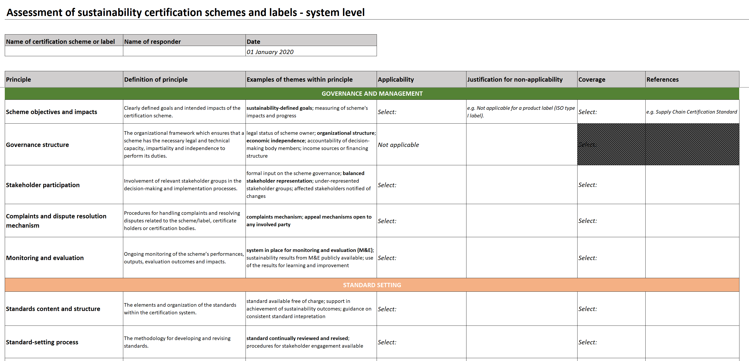
Testing process – pre-assessment
The assessor starts the assessment process by filling in the pre-assessment System-level tab of the Excel tool.
Based on the pre-assessment, principles beyond the scope of the CSL are excluded (Not applicable).
Example of what the pre-assessment of the System level looks like.

Slide 20
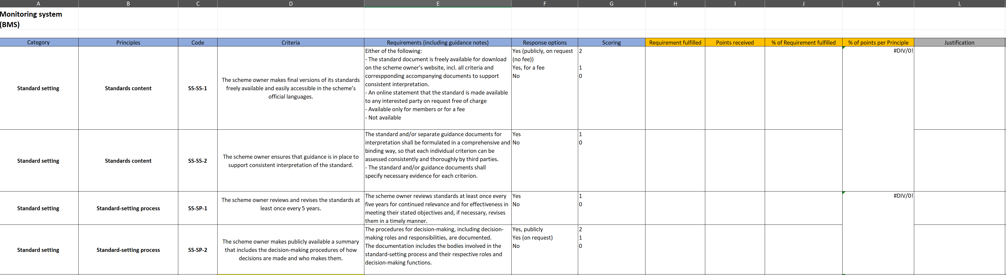
Testing process – assessment
In the next step, the assessor determines for each applicable requirement whether it is met (“Yes”/”No”/”Not Applicable”).
The assessor uses the “Justification” column to explain this decision and refer to the source where the relevant information was found.
Example of what the assessment looks like for a set of assurance requirements.

Slide 21
Testing process – assessment and scoring
Principle
Criterion A
Criterion B
Requirement A
Requirement B
Response options | Scoring
Yes, fully | 2
Yes, partially | 1
No | 0
Not Applicable | N/A
Principle | Criteria | 0 | 1 | 2 | Not applicable | Practical example | Disaggregated percent | Average value per principle
Standards content | The scheme owner makes consultation drafts and final versions of its standards freely available and easily accessible in the scheme’s official languages. | x | x | x |  | 1 | 50% | 50%
 | The standard document contains requirements that support achievement of the defined sustainability outcomes. | x | x |  |  | 0 | 0%
 | The scheme owner ensures that guidance is in place to support consistent interpretation of the standard. | x | x |  |  | 1 | 100%

Slide 22
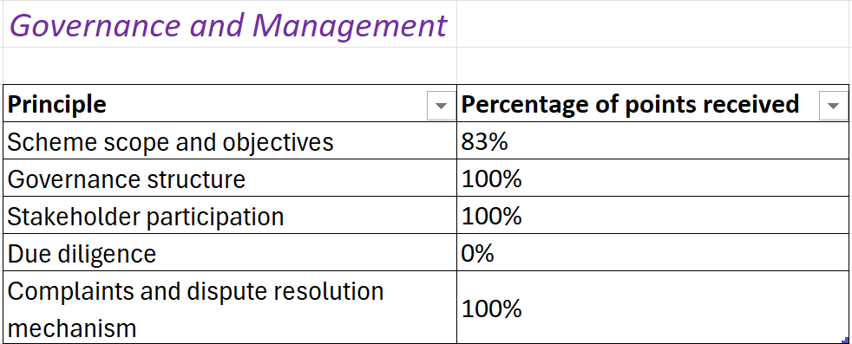
Visualization of results

Slide 23
Key insights from the System level testing
Requirements set by CSL vs. requirements required by the CAB
Auditing format and timing of field inspections
Mutual agreement with other CSLs
Stakeholders’ consultation inputs
In ecolabels, country-specific rules apply for certain requirements
Notes:
Although CSLs generally showed mature standard-setting and governance structures, differences emerged in:
Requirements set by CSL vs. requirements required by the CAB
Auditing format and timing of field inspections
Mutual agreement with other CSLs
Stakeholders consultation inputs
Percentage-based claims
In ecolabels, country-specific rules apply for certain requirements

Slide 24
BMT Content level
EDU4STADARDS Webinar
Iris Vural Gursel, Wageningen Food & Biobased Research
29 June 2026 – Online

Slide 25
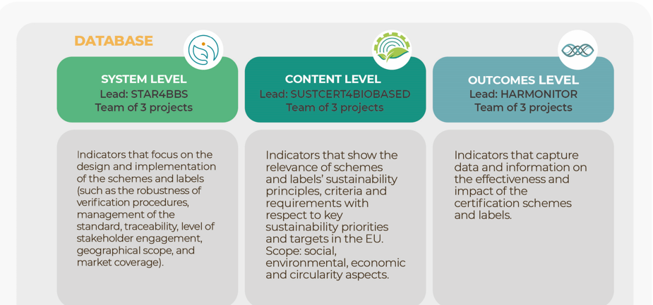
BMT Structure

Slide 26
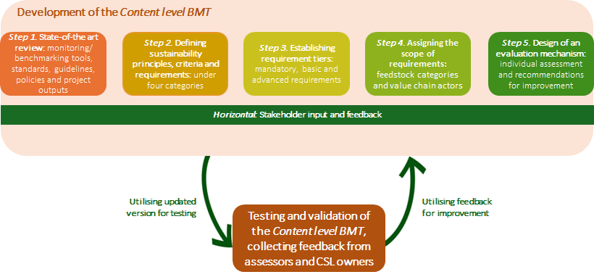
Content level Methodology

Slide 27
State-of-the-art Review
Monitoring tools and benchmarks
FAO SAFA Guidelines
ITC Standards map
SSCI Benchmarking requirements tool
SSCT by Siegelklarhait
WWF CAT tool
General standards and guidelines
The Accountability Framework Principles and guidance documents (Afi)
Cradle to Cradle
FAO Framework for environmental and social management 2022
HCV guidelines
ILO Standards and Principles
ISEAL guidelines
ISO Net zero guidelines
ISO 13065
NEN-EN 16751
SBTI FLAG requirements
UNCTAD 2020 Framework for the VSS assessment toolkit
UN High level Expert group Report on Net Zero
Policies and regulations
CSRD
EU Regulation 2022/996 on ILUC
EU Taxonomy
EUDR
ESRS
RED II
Past project outputs
CBE-JU study of the environmental sustainability requirements of biobased value chains and supply chains for bio-based industry
S2Biom D5.4
StarProbio D2.1, D8.2
Certification standards
Better Cotton
FSC
Global GAP
ISCC
Oeko Tex Standards
Regenagri Standards
RSB
RSPO
Ongoing project outputs
SUSTCERT4BIOBASED D1.2 Review of SCLs, factsheets
SUSTCERT4BIOBASED D3.1 Review on existing benchmarking tools and guidelines
STAR4BBS D1.1 Report on Policy Sustainability Targets
STAR4BBS D3.1 on Sustainability Indicators
HARMONITOR D4.1 Inventory of CSL requirements

Slide 28




Content Level Categories, Principles, Criteria and Requirements
Environment
Principles: 9
Circularity
Principles: 3
Economic
Principles: 3
Social
Principles: 4
Criteria: 45
Requirements: 93
Requirements: 17
Criteria: 7
Criteria: 31
Requirements:109
Requirements: 13
Criteria: 10
Mandatory: 22
Basic: 42
Advanced: 29
Mandatory: 2
Basic: 8
Advanced: 7
Mandatory: 34
Basic: 53
Advanced: 22
Mandatory: 2
Basic: 8
Advanced: 3

Slide 29
Sustainability Principles
Minimum backstop - Compliance to laws and regulations
Environment
Environmental management
Climate change management
Sustainable land use management
Protection of biodiversity
Chemical use management
Soil management
Air quality
Water quality and conservation
Energy use & efficiency
Circularity
Circular resource use
Circular design & material cycling
Responsible waste management
Social
Labour and human rights
Healthy and safe working conditions
Wellbeing of the local community
Wellbeing of consumers
Economic
Economic and financial viability
Fair business practice
Economic risk management

Slide 30
Requirement Tiers
Category
(4)
Principle
(19)
Criterion
(93)
Requirement
(232)
Mandatory (60):
requirements expected to be covered
Basic (111):
prescriptive/ detailed requirements
Advanced (61):
aspirational requirements
Social
Labour and human rights
The scheme requires fair remuneration of workers.
The worker is paid at least a living wage or the wage negotiated through a collective bargaining agreement (whichever is higher).
Workers are provided with proof of payment for each paycheck.
Measures are taken to limit the reduction of workers’ pay and/or benefits.
Mandatory
Basic
Advanced
Example:

Slide 31
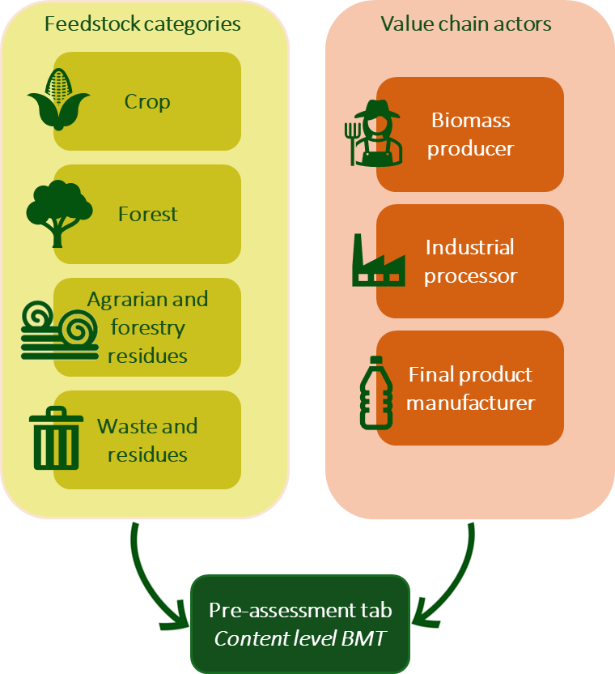
Scope & pre-assessment
To determine the scope of the assessment, applicable feedstocks, value chains actors and principles to the standards are identified beforehand.
  Goal is to avoid scoring schemes on topics that are outside of scope or inapplicable.
A scope-defining questionnaire is sent to CSLs to identify relevant principles.
  Justification for non-applicability is required.

Slide 32
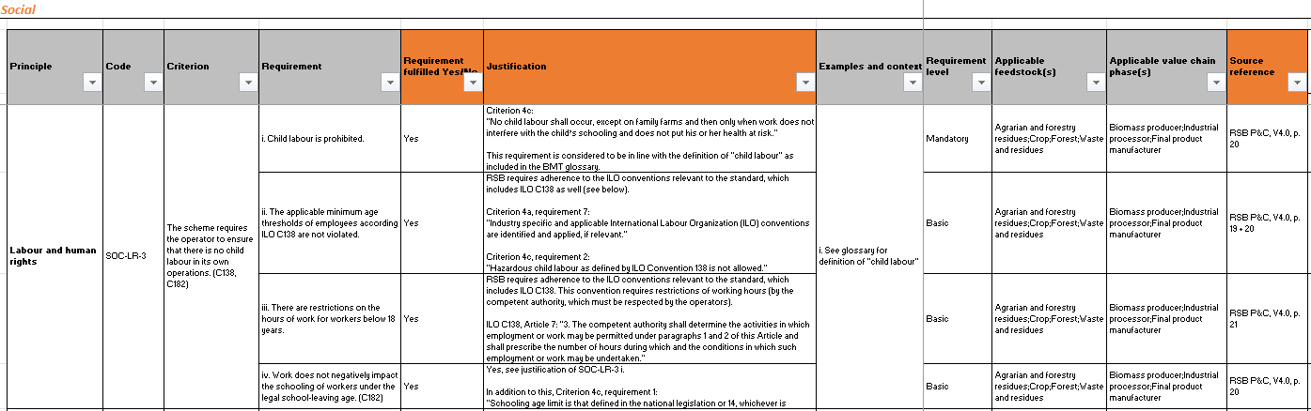
Testing process – Assessment
The assessor determines for each applicable requirement whether it is covered (“Yes”/”No”).
The assessor uses the “Justification” and “Source reference” columns to explain this decision and refer to the source where the relevant information was found.
Example of what the assessment looks like for a set of social requirements:

Slide 33
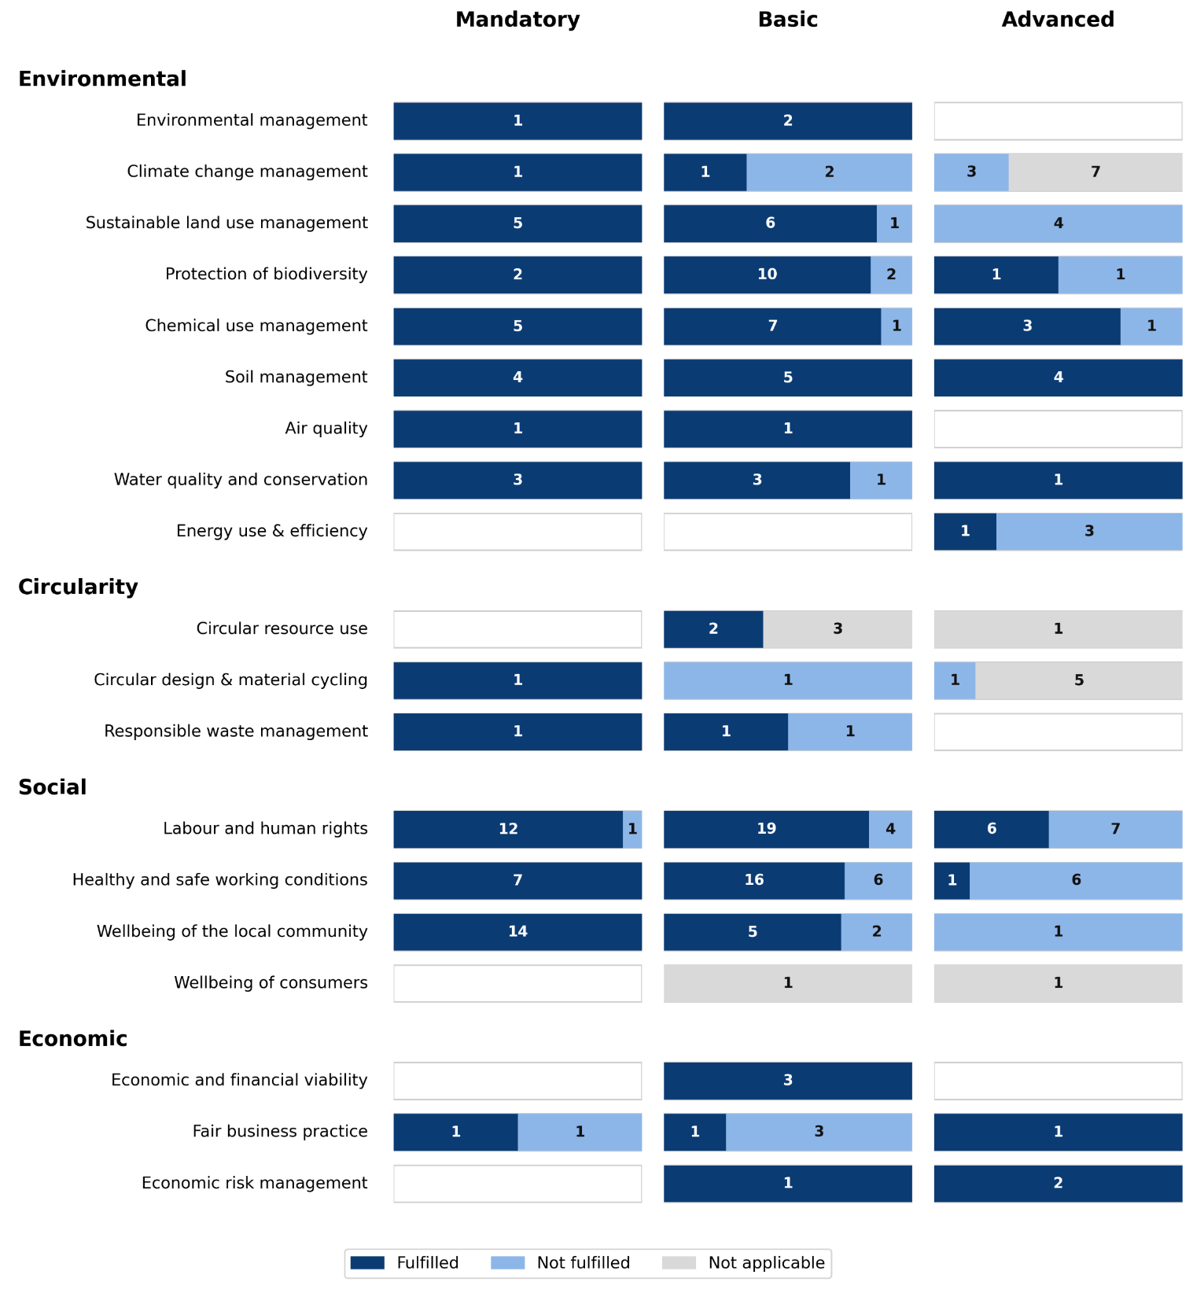
Assessment Results
Example assessment results for a sustainability certification scheme for biobased materials and products :
Goal is to provide transparency on the scoring and avoid comparisons of CSLs.
  No single scores are calculated.
  Results are provided per principle, per requirement level
  Each individual assessment provides targeted recommendations for improvement for the scheme/label under consideration.

Slide 34

THANK YOU FOR YOUR ATTENTION!
Contacts:
Iris Vural Gursel: iris.vuralgursel@wur.nl
https://sustcert4biobased.eu/resources/deliverables/
https://zenodo.org/communities/sustcert4biobasedproject
SUSTCERT4BIOBASED D3.2 Evaluation of existing schemes and labels, https://zenodo.org/records/16993921
Vural Gursel I. et al. Driving continuous improvement of sustainability certification for industrial biobased systems through comprehensive sustainability requirements. Biofpr. forthcoming
This presentation has been produced by ICONS in the context of the Horizon Results Booster services delivered to SUSTCERT4BIOBASED (GA 101059785 ), HARMONITOR (GA 101060133), and STAR4BBS (GA 101060588). This product doesn’t reflect the views of the European Commission.

Slide 35
BMT Outcome level
EDU4STADARDS Webinar
Maulidia Khairani, Utrecht University
29 June 2026 – Online

Slide 36

BMT Structure

Slide 37
Collaborative approach in developing the methodology
Research and literature review
Identify key challenges and essentials elements for the design of outcome level monitoring system
Framework design
Define key elements
Define scope of the methodology
Stakeholder feedback
Internal feedback session
Workshop with external stakeholders

Slide 38


Scope of measurable progress
A streamlined methodology for monitoring the measurable progress of a scheme over time
Relative
Certified
Outcome
Quantitative
Absolute
Non-certified
Output
Focus on longitudinal data
Qualitative

Slide 39
The foundations of the BMT outcome level
Scheme improvements
Does CSL continuously raise its sustainability standards by taking into account the progress of certificate holders, developments in science and policy, and stakeholder feedback?
CSL impacts as defined in the BMT outcome level
To what extent does certification lead to improved sustainability performance of its certificate holders?
Certificate-holder improvements
To what extent does progress at scheme level translate into measurable sustainability progress at certificate-holder level?
Evidence of measurable progress?
39

Slide 40

Structure of the BMT Outcome Level
2 Categories
5 Principles
8 Criteria
24 Indicators
Example evaluation points
Measurable progress of certificate holders
Measurable progress of certificate holders
Criterion A.1
Indicator A.1.1-A.1.6
Add-on-1
Effectiveness of sustainability management plan, assessment of sustainability hotspots
Measurable progress of CSL
Impact monitoring of own scheme
Criterion B.1, B.2
Indicator B.1.1-B.1.2, B.2.1-B.2.5
Quantitative assessment of sustainability outcomes
To identify gaps and encourage continuous improvement
Procedure to validate impacts
Criterion C.1, C.2 (add-on)
Indicator C.1.1-C.1.2
Add-on-2
Verification by third-parties
Possible scoring:
  Fully: if all conditions in the indicator are fully met
  Partly: if at least one of the conditions is partly met or missing
  Missing: if no evidence is found
  Not applicable: if considered not applicable
Reporting or demonstration of impacts
Criterion D.1
Indicator D.1.1-D.1.5
Regular reporting to track progress, allow comparisons, and explain improvements
Continuous improvement of scheme
Criterion E.1, F.1
Indicator E.1.1-E.1.2, F.1.1-F.1.2
Revision of standards based on operator progress
Applicability: All CSLs, certification schemes, type I ecolabels
Guidance notes
40

Slide 41
Example of BMT Outcome Level Assessment
Category: Measurable progress of scheme owners
Principle: Impact monitoring of own scheme
Criterion: B.2 The scheme regularly measures their progress towards intended social, economic, and environmental impacts through performance, outcome, and impact evaluation.
Indicator Code | Indicators | Applicability | Fulfillment | Justification or Evidence
B.3.4 | The scheme quantitatively measures at least one indicator related to climate change every year.
Fully
The CSL has quantitative indicators (annual GHG emissions, avoided emissions) to measure impact relevant to climate change. The monitoring indicators are defined in the M&E System [1].
All CSLs

Slide 42
Example of implementation
Review indicators and its applicability
Review relevant evidence & interviews
Visualize results
Benchmark against indicators
Results are shared with CSL owners for validation and feedback
42

Slide 43

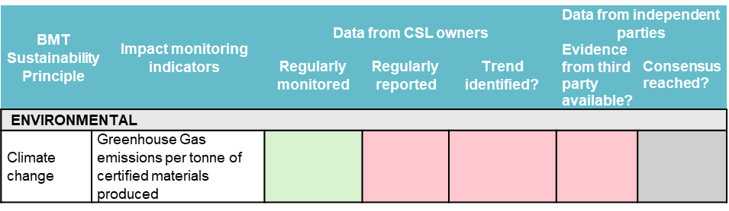
Database of monitoring indicators
Goals: To promote cross-learning among CSLs
Example
Impact areas
Climate change
Sustainability impact indicator monitored by the scheme
GHG emissions per tonne of certified materials produced
Practice or performance-based?
Performance
Level of data collected
Operator
Data collection method
Through audit by Certification Bodies
Frequency of data collection
Yearly
Is the impact indicator regularly reported by the scheme?
Yes
How often is the impact indicator reported?
Yearly
How is the impact indicator reported?
Aggregated based on all certificate holders
Are results validated?
Yes

Slide 44
Overview of Results
Measurable progress of operators
Growing focus on impact monitoring
Adoption of Theory of Change or similar frameworks
Impact monitoring of own scheme
Mainly performance monitoring
Quantification of outcomes is feasible, mostly focus on the environmental dimension (e.g. GHG emissions)
Procedure to validate impacts
Gaps in impact evaluation and reporting
Reporting or demonstration of impacts
Demonstration of measurable progress relies on infrastructure, resources, and collaboration with stakeholders
Continuous improvement of scheme

Slide 45
THANK YOU FOR YOUR ATTENTION!
Martin Junginger - h.m.junginger@uu.nl
Li Shen – l.shen@uu.nl
Maulidia Khairani – m.khairani@uu.nl
This presentation has been produced by ICONS in the context of the Horizon Results Booster services delivered to SUSTCERT4BIOBASED (GA 101059785 ), HARMONITOR (GA 101060133), and STAR4BBS (GA 101060588). This product doesn’t reflect the views of the European Commission.

