Slide 1


Do we know what we are drinking? Microplastic monirtoring as the foundation of EU environmental safety
Dąbrowska Weronika, Boczek Szymon, Pałatowski Aleksander

Slide 2
Topic: Monitoring of microplastics in drinking water – new technical challenges. Problem: The presence of <5 mm particles in the hydrological cycle and their impact on ecosystems. Project objective: Integration of environmental engineering, standardization and strategic interests of the EU (Green Deal and Digitalization). Thesis: Effective health care requires synergy between technology and uniform legal standards.

Slide 3
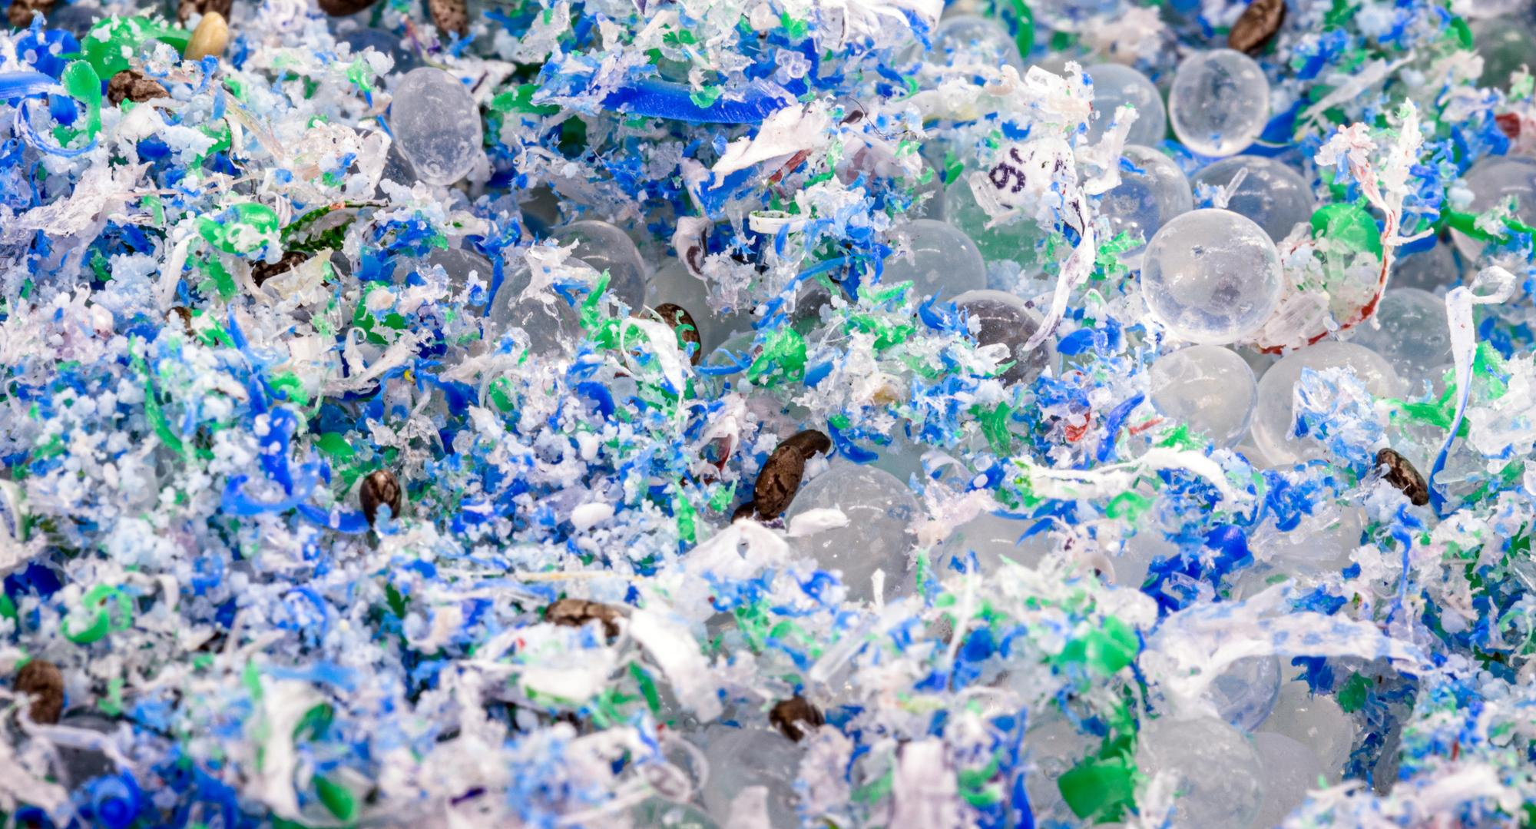
Impact of microplastics on human health

Slide 4
Scale of intake: It is estimated that the average person ingests about 5 grams of microplastics per week. These particles are present almost everywhere: in water, salt, sugar, honey, as well as in fruits and vegetables, which absorb them from contaminated soil through the root system. Effects on the body: Studies show that the consumption of microplastics can contribute to the development of civilization diseases, such as: insulin resistance, obesity and diabetes; cardiovascular problems (e.g. cardiomyopathies); cancerous lesions, especially within the pancreas Cell penetration: The smallest molecules (nanovesicles about 100 nm in size) have the ability to transport plastic with blood to almost every cell in the body, including the brain, liver and ovaries.
https://www.youtube.com/watch?v=ZHCgA-n5wRw

Slide 5
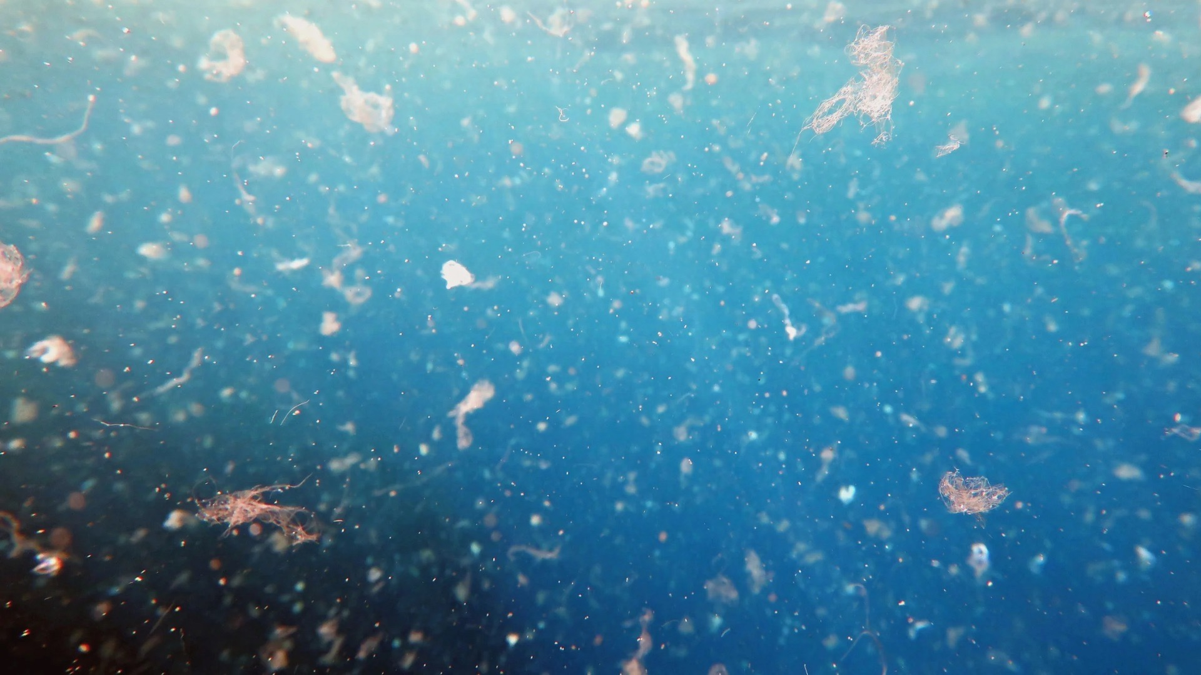
The European Green Deal—Why are we doing it?

Slide 6
A new growth strategy: Transforming the EU into a modern, resource-efficient and competitive economy. Neutrality 2050: The goal of achieving net-zero emissions and protecting natural capital. Decoupling: Decoupling economic growth from the consumption of natural resources. Just transition: Protecting the health and well-being of citizens from environmental risks as a priority.

Slide 7
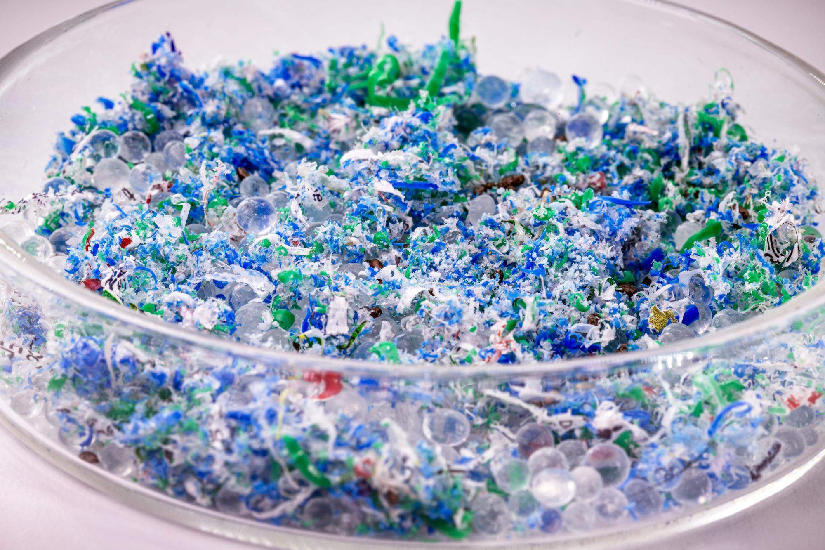
Environmental Engineering – Technical Solutions

Slide 8
Technical barriers: Traditional methods (coagulation/sand) remove 70-95% of microplastics, but fail at particles <10 μm. Advanced solutions: Membrane bioreactors (MBRs) achieve an efficiency of over 99.9%. Innovations 2025/26: Application of sol-gel filtration and advanced oxidation processes (AOP). Sludge management: The need to neutralize microplastics trapped in sewage sludge.

Slide 9
Standardization – New ISO Standards and EU Regulations
ISO 16094-2:2025: A new international standard for the analysis of microplastics in drinking water. EU harmonisation: Decision 2024/1441 introduces a uniform measurement methodology in all Member States. Data comparability: Standards enable the building of reliable databases and effective legislation. Competitive advantage: European technical standards set the global directions for industrial development.

Slide 10
Bibliography
Komisja Europejska: Strona główna Europejskiego Zielonego Ładu – Komunikat COM/2019/640. EUR-Lex: 52019DC0640
Oficjalny komunikat prasowy: The European Green Deal sets out how to make Europe the first climate-neutral continent by 2050.
Mechanizm Sprawiedliwej Transformacji: The Just Transition Mechanism explained.
ISO 16094-2:2025 – Water quality — Analysis of microplastic in water — Part 2: Vibrational spectroscopy methods for waters with low content of suspended solids.
Decyzja Delegowana (UE) 2024/1441 (Metodologia pomiaru) EUR-Lex: 32024D1441
ISO 16094-2:2025 (Analiza mikroplastiku) ; ISO.org: Standard 83483
WHO: Microplastics in drinking-water; WHO Publications
https://uwm.edu.pl/aktualnosci/jak-mikroplastik-wplywa-na-nasz-organizm

