Slide 1
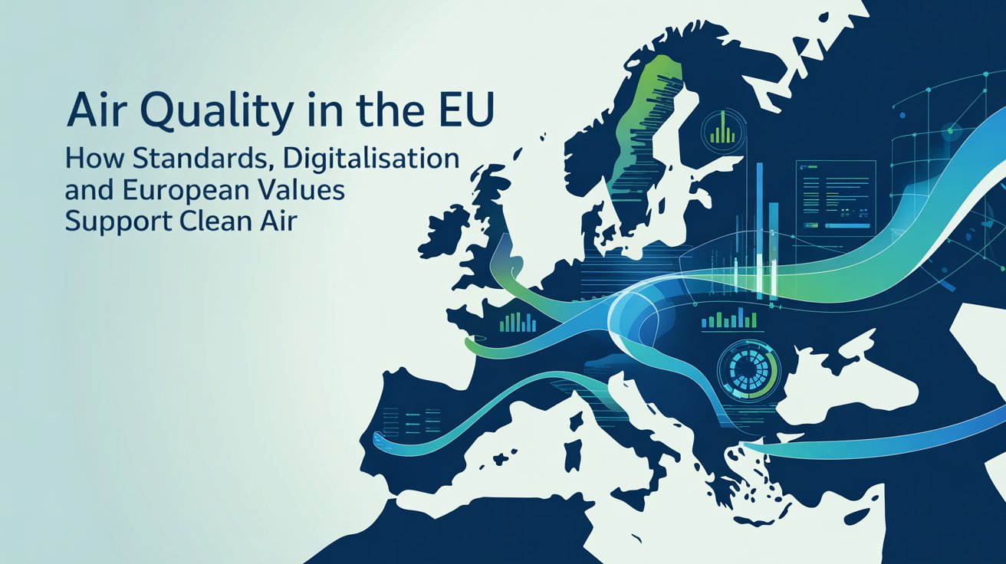
Authors:
Inż. Marta pałdyna
Inż. Paulina Taibert
Inż. Jan Stefański
Enviromental Enginnering, Master Degree Year 1

Slide 2
Growing problem with air quality in EU
Growing air quality problem in the EU
Air pollution remains a serious threat to public health in the European Union
The main sources of emissions include transport, energy production, industry, and residential heating
The problem is transboundary in nature and negatively affects human health, the environment, and the economy
The EU is strengthening regulations, developing digital monitoring systems, and grounding its actions in European values

Slide 3
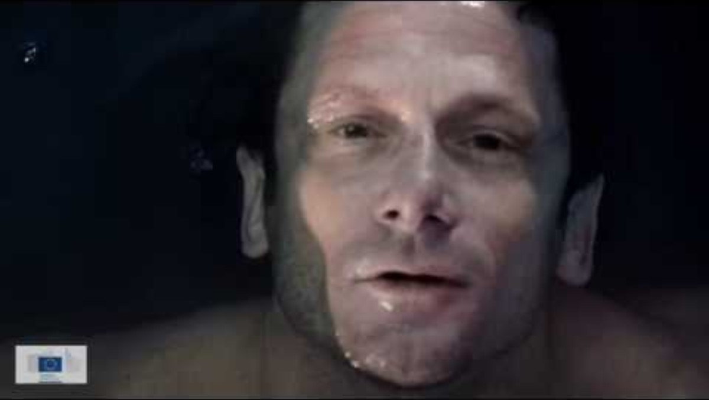
Every breath you take - Air pollution in Europe - Year of Air: https://www.youtube.com/watch?v=8lzKpucqwOQ

Slide 4
Main air pollutants
Particulate matter (PM₁₀ and PM₂.₅) – fine solid and liquid particles that can penetrate the respiratory system and bloodstream
Nitrogen oxides (NOₓ) – gases mainly generated by transport and energy production, contributing to smog formation and respiratory irritation
Sulphur dioxide (SO₂) – pollution linked to fossil fuel combustion, harmful to human health and ecosystems
Tropospheric ozone (O₃) – a secondary pollutant formed through chemical reactions in the atmosphere
Volatile organic compounds (VOCs) – originating from industry and transport, involved in the formation of photochemical smog

Slide 5
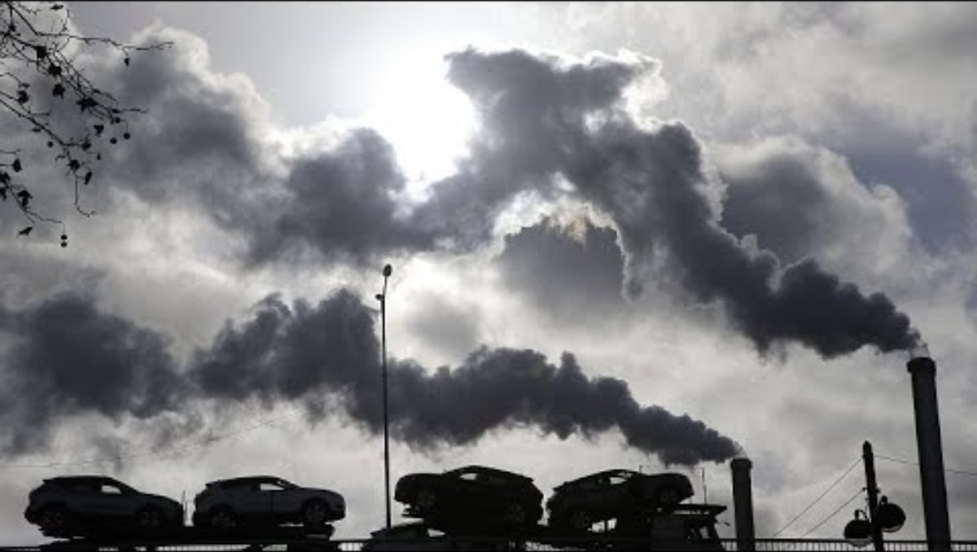
Levels of air pollution in Europe 'still too high', warns EU environment agency: https://www.youtube.com/watch?v=HoqQFGY1cx8

Slide 6
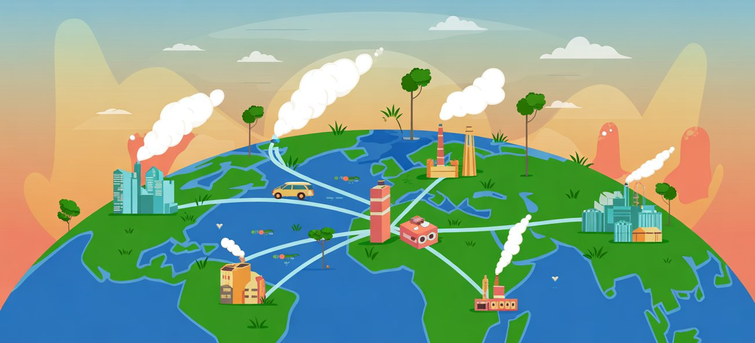
Sources of air pollution
Transport – emissions from cars, trucks, airplanes, and ships
Energy production – fossil fuel combustion in power plants and heating facilities
Industry – emissions from industrial processes, chemical production, and metallurgy
Residential heating – burning coal, wood, and other solid fuels in homes
Agriculture – emissions of ammonia, methane, and dust from fertilizers and livestock

Slide 7
European Green deal and air quality
The European Green Deal supports emission reduction and the improvement of air quality in line with existing EU standards (e.g., PM₂.₅, NO₂, SO₂)
Promotes the transition to renewable energy and low-emission transport to comply with emission limits set by EU directives
Supports the modernization of industry and buildings, reducing emissions from the energy and residential sectors in accordance with environmental standards
Integrates environmental monitoring and digitalization, enabling compliance tracking and better air quality management
Aligns environmental protection actions with EU values: health, fairness, and sustainable development

Slide 8
Sample Standards in air quality protection
EU Ambient Air Quality Standards – legally binding limit values for pollutants such as PM₂.₅, PM₁₀, NO₂, SO₂, O₃, and heavy metals
ISO standards – e.g., ISO 4225 (air quality vocabulary), ISO 16000 series (indoor air), ISO 8178 (engine emissions) for measurement and monitoring
CEN/EN methods – European reference methods for measuring pollutants (EN 12341 for PM₁₀/PM₂.₅, EN 14211 for NO₂, EN 14902 for heavy metals in PM₁₀)
Digital and sensor standards – technical specifications for air quality sensors (e.g., CEN/TS 17660‑1) to ensure accurate monitoring and interoperability
Standards ensure reliable monitoring, compliance with EU limits, and harmonization across member states

Slide 9
Key ISO Standards Related to Air Quality
ISO 4225 – Air quality — General aspects — Vocabulary​ Scope:​ Terminology related to air quality​ Definitions of key terms such as air pollution, emission, immission, and particulate matter​ Importance:​ Ensures consistent and harmonized terminology​ Provides a common basis for air quality research and regulations​
ISO 16000 Series – Indoor Air Quality​ Scope:​ Assessment of indoor air quality​ Measurement of pollutants such as:​ Volatile organic compounds (VOCs)​ Formaldehyde​ Microorganisms​ Odours​ Importance:​ Highly relevant for human health​ Applied in residential buildings, offices, schools, and public facilities​
ISO 8178 Series – Exhaust Emission Measurement​ Scope:​ Measurement of exhaust emissions from internal combustion engines​ Covers pollutants such as NOₓ, CO, and particulate matter​ Importance:​ Important for the transport and energy sectors​ Supports emission reduction and compliance with air quality regulations​
ISO 25140 – Stationary Source Emissions​ Scope:​ Measurement of emissions from stationary industrial sources​ Importance:​ Supports industrial emission control​ Helps ensure compliance with environmental regulations
ISO 14000 Series – Environmental Management Systems​ Scope:​ Environmental management systems (e.g. ISO 14001)​ Management of environmental impacts, including air emissions​ Importance:​ Indirectly contributes to improved air quality​ Widely implemented in industry and public administration​s ​
ISO Standards for Air Sampling and Measurement (e.g. ISO 4224 / ISO 4226)​ Scope:​ Air sampling methods​ Determination of concentrations of gaseous and particulate pollutants​
​

Slide 10
Digital tools in air quality monitoring
Continuous air quality monitoring networks – real-time measurement of pollutants (PM₂.₅, NO₂, O₃, SO₂) across urban and rural areas
Satellite observation systems – tracking regional and transboundary pollution, e.g., Copernicus Atmosphere Monitoring Service (CAMS)
Low-cost sensor networks – distributed sensors providing localized air quality data for citizens and municipalities
Data platforms and dashboards – centralized collection, visualization, and analysis of air quality data for policymakers and the public
Digital reporting and compliance tools – support adherence to EU standards, alert systems, and predictive modeling for pollution events

Slide 11
Intesection of standards and digitalization
Standards ensure consistency – EU and ISO norms define what, how, and where pollutants should be measured
Digital tools enable compliance – sensors, networks, and data platforms help track adherence to legal limits in real time
Integrated monitoring systems – combine standardized measurement methods with digital data collection for accurate reporting
Evidence-based policy and management – harmonized standards plus digital monitoring support informed decisions and targeted interventions to improve air quality

Slide 12
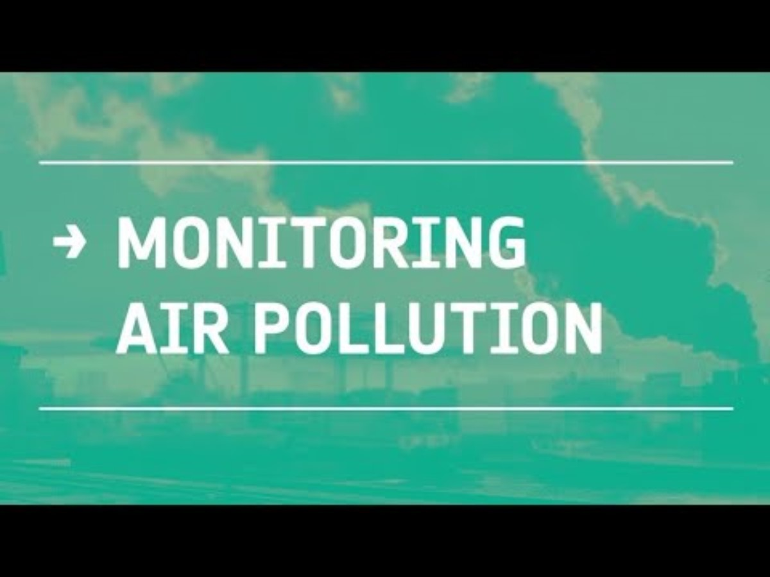
Monitoring Air Pollution: https://youtu.be/YkWUQlnrIeI

Slide 13
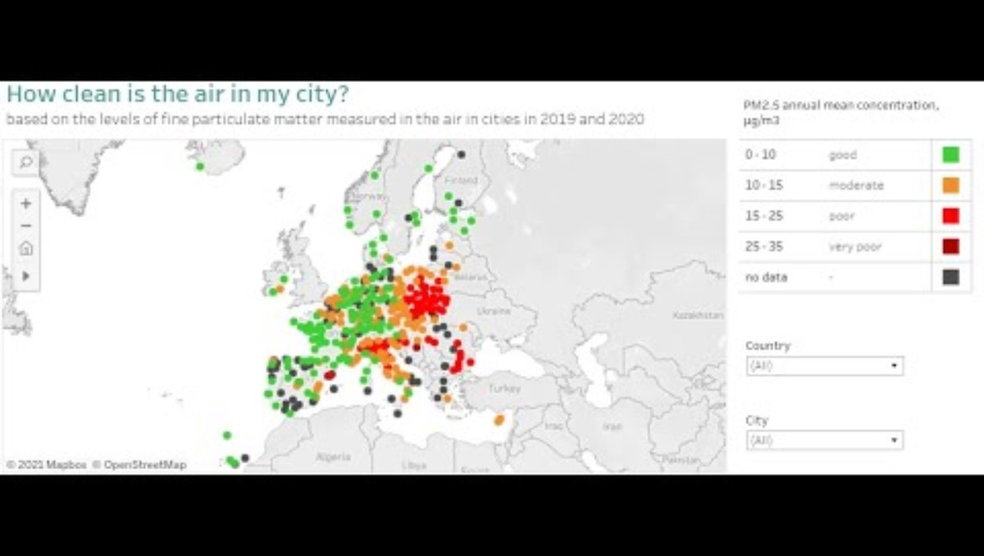
European city air quality viewer: https://youtu.be/Y9n_Bnzkotg

Slide 14
EU values as the foundation for action
Health protection – safeguarding citizens from air pollution-related diseases
Environmental justice – ensuring all regions and communities have equal access to clean air
Sustainable development – balancing economic growth with environmental preservation
Solidarity and cooperation – coordinating cross-border actions and sharing best practices among member states
Transparency and citizen engagement – providing accessible data and involving the public in air quality initiatives

Slide 15
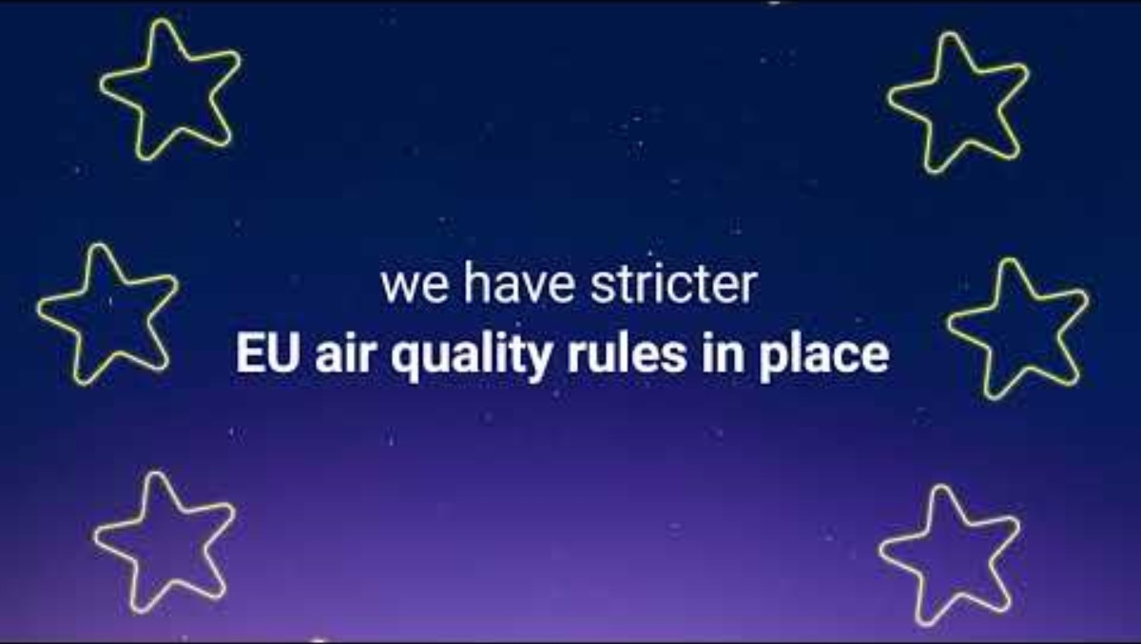
How clean is the air where you live?: https://youtu.be/KY6khpAfnww

Slide 16
CASE study: Air Quality Initiatives in the eu
Berlin, Germany – Digital Air Monitoring Network​
Real-time monitoring of urban air quality with over 100 sensors​
Data publicly available through dashboards and apps
Copenhagen, Denmark – Low-Emission Zones​
Restriction of high-emission vehicles in the city center​
Significant reduction in NO₂ and PM₂.₅ concentrations​
Warsaw, Poland – Residential Heating Modernization​
Replacement of coal stoves with low-emission or renewable heating​
Measurable improvement in winter air quality​
EU-wide – Copernicus Atmosphere Monitoring Service (CAMS)​
Satellite-based tracking of transboundary pollution​
Supports policy-making, alerts, and compliance with EU standards​

Slide 17
Benefits for the economy and society
Public health improvement – fewer respiratory and cardiovascular diseases reduce healthcare costs
Economic gains – cleaner air supports productivity, tourism, and reduces absenteeism
Innovation and green jobs – promotion of low-emission technologies and renewable energy sectors
Compliance with EU policies – harmonized standards and digital monitoring reduce legal risks and enhance international competitiveness
Social well-being and equity – improved air quality increases quality of life and ensures fair access to a healthy environment

Slide 18
Civic engamement and environmental justice
The role of residents in enforcing air quality standards
Using public air quality data and digital tools (apps, EU platforms)
Reporting violations of standards (e.g. PM₂.₅, NO₂) to local authorities and inspection bodies
Participating in public consultations and local initiatives
Supporting equal access to clean air as a fundamental civic right

Slide 19
Shared Responsibility and EU Values
Clean air as a pillar of health, solidarity, and sustainable development
Protection of public health as a core value of the European Union
Intergenerational justice and responsibility towards future generations
Cooperation between residents, local authorities, and EU institutions
Building social pressure to ensure effective implementation of environmental standards and policies

Slide 20
Summary
Air pollution remains a major challenge in the EU, affecting health, the environment, and the economy
EU standards and regulations (PM₂.₅, NO₂, SO₂, heavy metals) provide clear limits and measurement methods
Digital tools and monitoring systems enhance compliance, real-time tracking, and data-driven decision-making
European values – health, sustainability, fairness, and solidarity – underpin all air quality actions
Green Deal and case studies show that combining standards, technology, and policy delivers tangible benefits for citizens and the economy
Shared Responsibility – Achieving Green Deal goals requires synergy between technology, strict regulations, and grassroots social pressure for the well-being of future generations
Civic Engagement – Residents play a key role in enforcing standards by using digital monitoring tools and reporting air quality violations to local authorities
Local Successes – Case studies from Copenhagen, Berlin, and Warsaw prove that modern transport and heating policies bring measurable health and economic benefits
Global Challenge: Air pollution from transport, energy, and industry remains a critical threat to public health, the environment, and the economy across the EU
Thanks you for your attention

